Slide 1
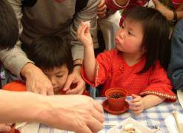
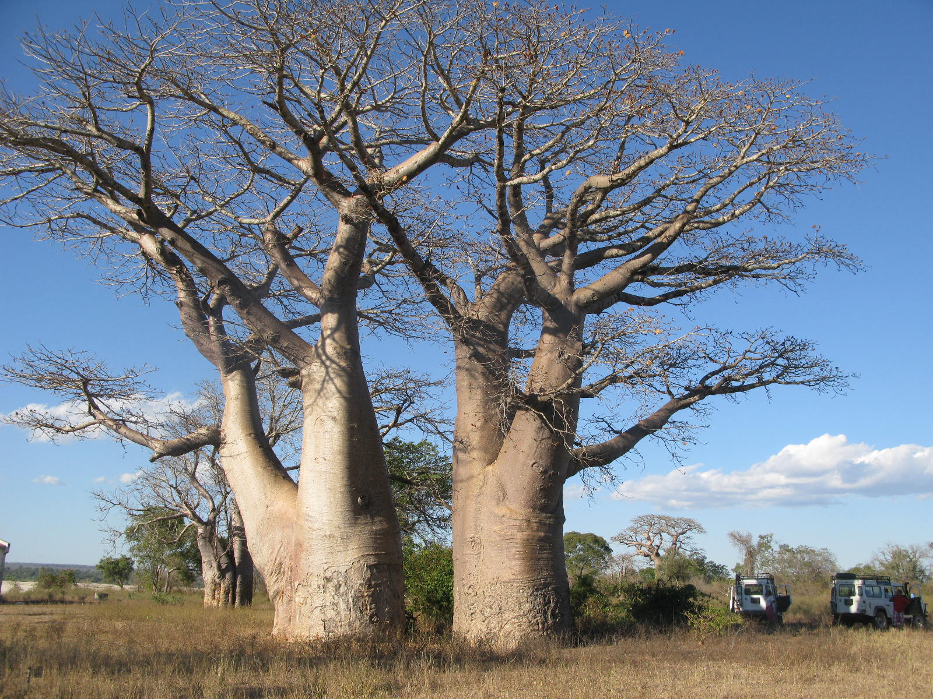
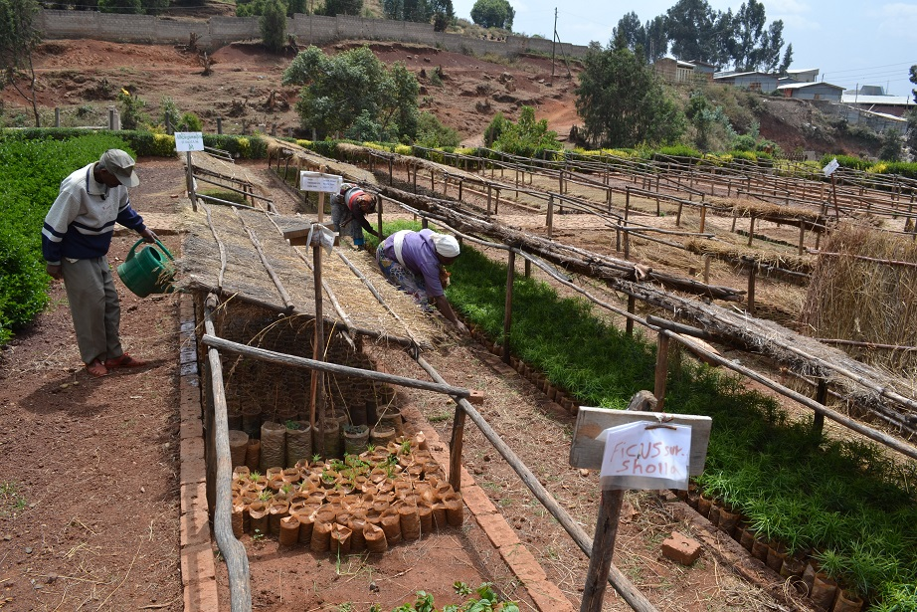

Module 6: Data Management
People
Plants
Places
Science

Slide 2
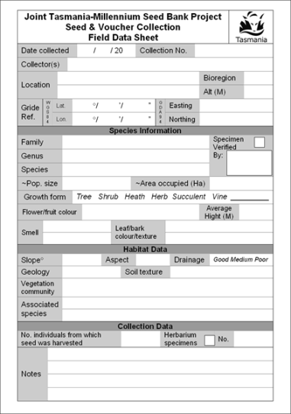
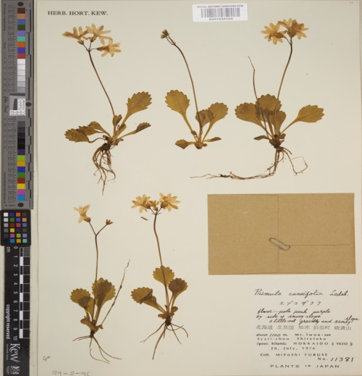



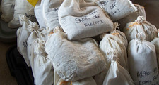
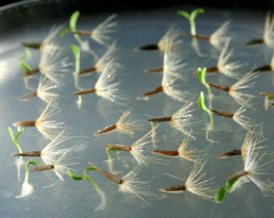
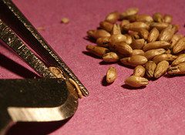
Data
Collection data
Additional data
Processing data

Slide 3
Unique Accession Number
Data
Collection data
Additional data
Processing data

Slide 4
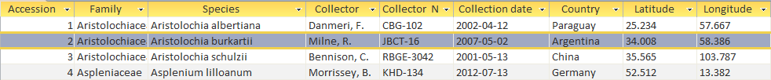
Seed bank database
Collection data - Accession no., coll no. name/date, location, species, population..
Processing data - Size of collection, germination tests, cut tests…
Additional data - Sharing agreements (MOU, ASBA), CITES status, Threat assessment…

Slide 5
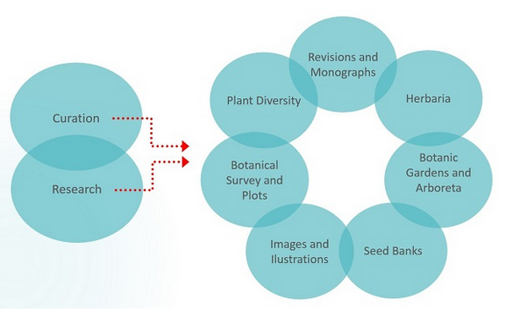
Databases
Brahms http://herbaria.plants.ox.ac.uk/bol/
BGBase http://www.bg-base.com/
IrisBG http://www.irisbg.com/

