Slide 1
Module 4: Post Collection – Cleaning, Drying & Storage
People
Plants
Places
Science

Slide 2
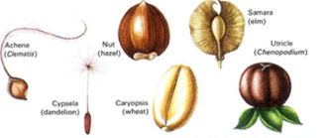
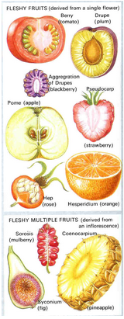
Fruit Types
Dry dehiscent fruit
Dry indehiscent fruit
Fleshy fruits derived from a single flower
Fleshy multiple fruits derived from an inflorescence
Flowering plants of the World Heywood, V.H.

Slide 3
Fruit
Dry fruit Fleshy fruit
Wash fleshy fruit in a sieve to remove fruit pulp. If hard cut open and remove seed
Dry slowly in ambient conditions for up to two weeks
Clean
Re-dry, package and store

Slide 4
Seed Quality
Aim: To collect healthy seed. Collect seed when it is ready

Slide 5
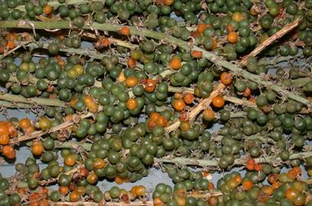
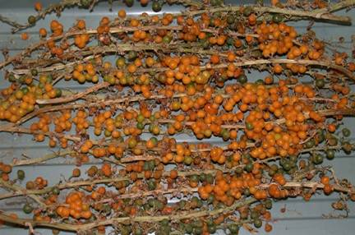
Developmental Variation
Flowering and fruiting times can be widely spread
Seed collections may include a range of maturities
Careless handling could reduce the storability of the collection
Remove seeds from fleshy fruits as soon as morphological signs (e.g. fruit colour) indicate that they are fully ripe.

Slide 6
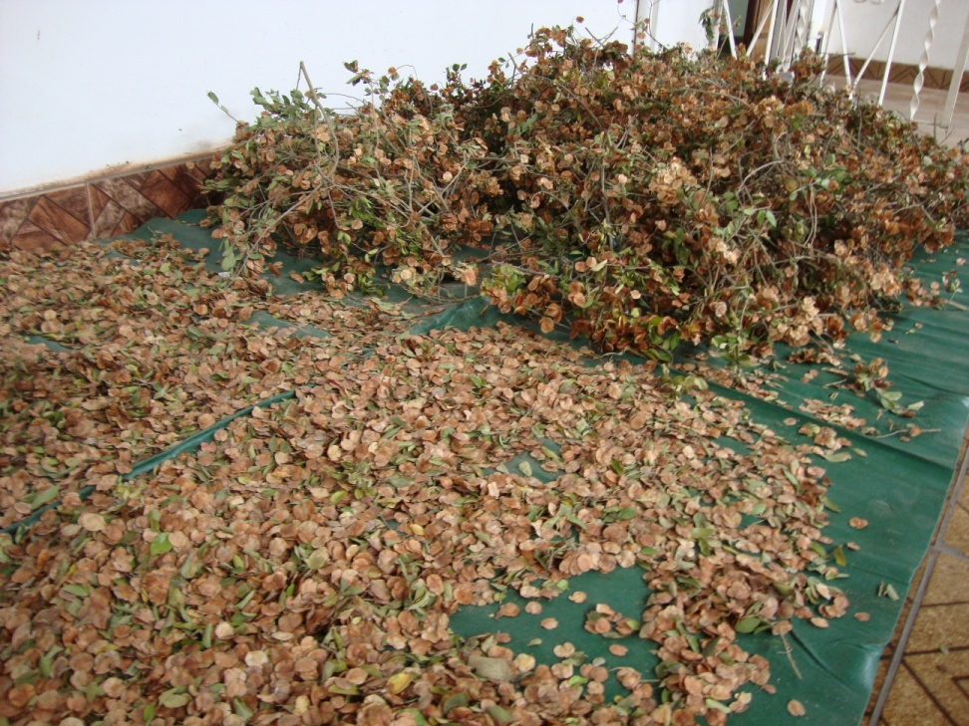
Slow drying enables continued ripening
Hymenocardia ulmoides

Slide 7
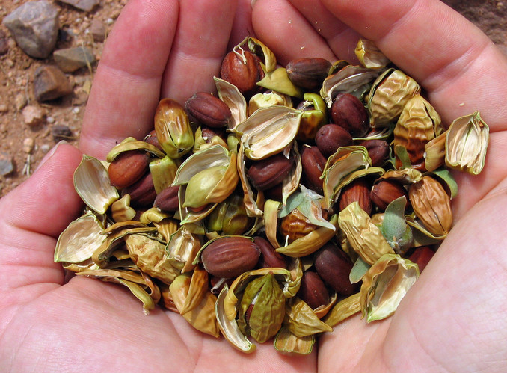
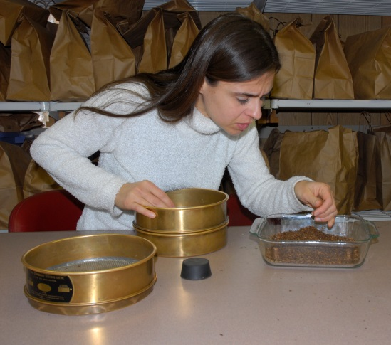
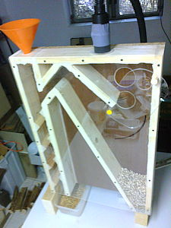
Seed cleaning techniques
Using sieves of different mesh sizes, and a rubber bung to separate seeds from debris
Using a seed aspirator to remove empty/infested seeds or debris
Hand removing debris one fruit at a time

Slide 8
Keep safe!
Use masks, gloves and eye protection for toxic species.

Slide 9
Seed drying
Seed longevity doubles for every 1% reduction in mc or 10% reduction in RH
Seed longevity doubles for every 5°C drop in temperature
In a seedbank low moisture content and low temperature are used to extend longevity, postpone germination and prevent pest attacks.
Typically seeds are dried to 3-7% mc 10-15% eRH and then stored at -20°C

Slide 10
Seed drying
Properties of air
• What is moisture content (Mc)?
This is the amount of water in a given amount of substance.
• What is relative humidity (RH)?
Air holds water vapour and is shown as a percentage. This is called relative humidity (RH)
What is equilibrium relative humidity (eRH)?
The measured relative humidity when the loss and gain of moisture between a substance and the surrounding air is in equilibrium

Slide 11
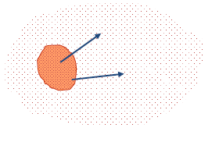
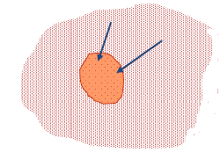
Seed drying
Seeds are hygroscopic - absorb and lose moisture from the surrounding air.
Dry air
Moisture moves from the seed to the air
Wet seed
Wet air
Moisture moves from air to the seed
Dry seed

Slide 12
Seed drying
Seeds are hygroscopic - absorb and lose moisture from the surrounding air.
Drying seed
Dry air
Moisture moves from the seed to the air
Wet seed
Wet air
Moisture moves from air to the seed
Dry seed

Slide 13
Seed drying
Aim to increase air speed
Aim to increase the amount of air that is in contact with seed

Slide 14
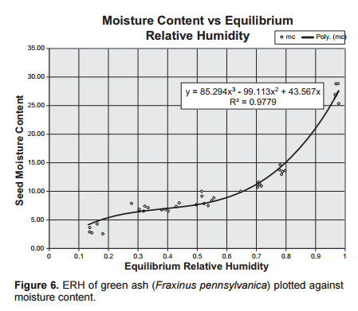
Seed drying
Seeds need to be placed in porous bags or spread in thin layers
Temperature of 10-25°C is recommended for seed drying
Relative humidity of the air should be 10-15% RH
Freshly collected seed
Optimum eRH and Mc
Lower is detrimental
Taken from Karrfalt, 2010

Slide 15
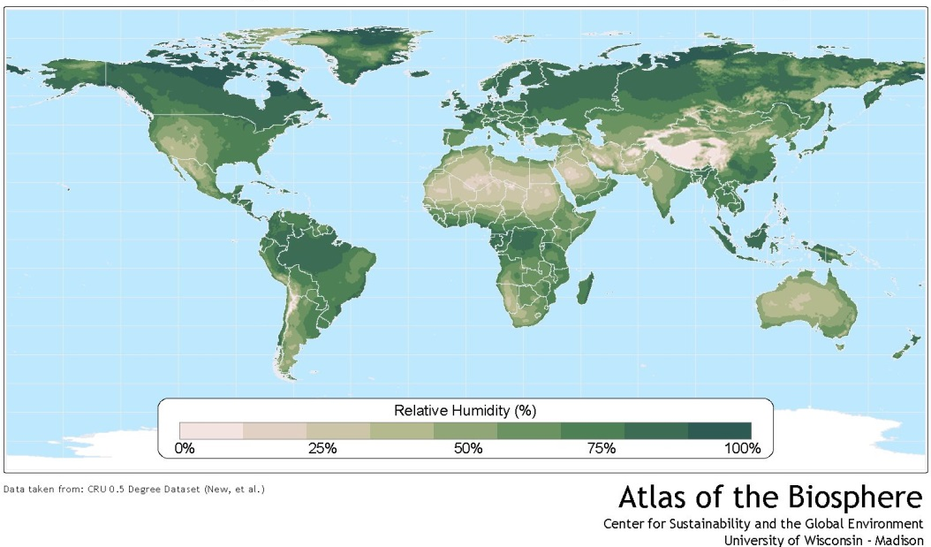
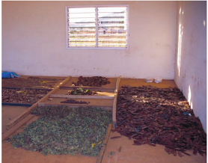
Ambient drying
In dry warm regions (Australia, North Africa, West North America) seeds can be dried in ambient conditions in the shade
MC increases over night and when it rains. Seeds should be raked together and covered
Seeds should be spread out during the day

Slide 16
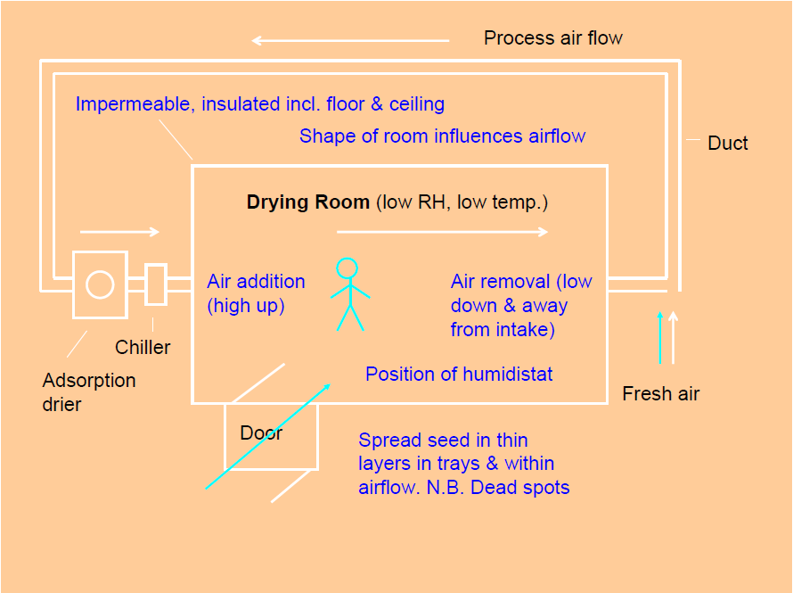
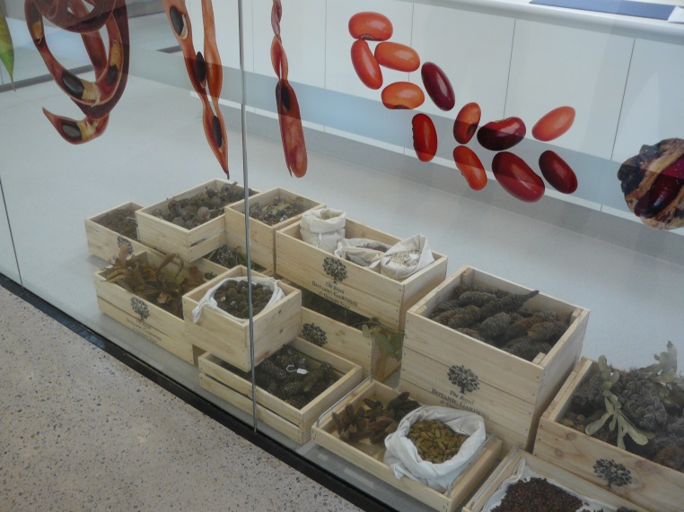
Dry Room
Essential for large quantities of material.

Slide 17
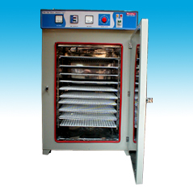
Incubator Drying
Incubators set to 18C can achieve an internal humidity of 15% RH
Seed should be placed in porous bags so that moisture can leave the seed

Slide 18
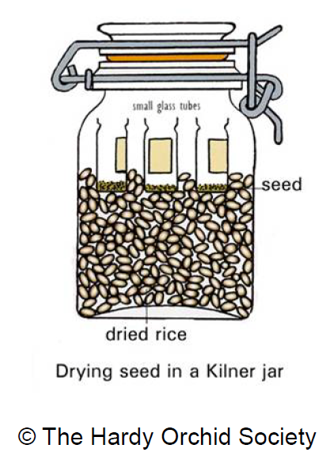
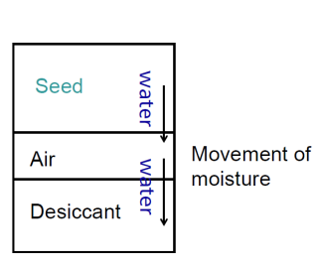
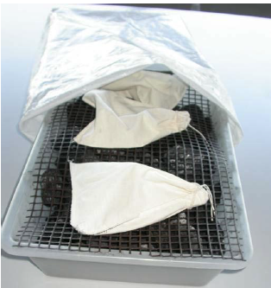
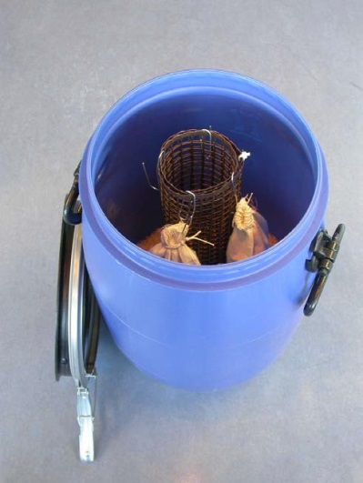
Using Desiccants
Rice Charcoal Silica gel
Re-usable if oven dried

Slide 19
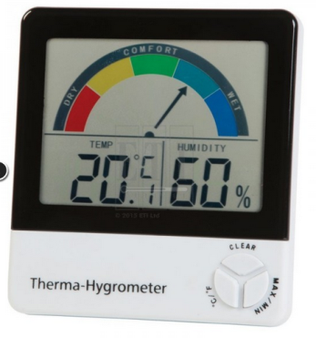
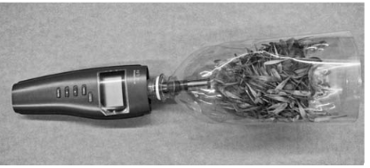
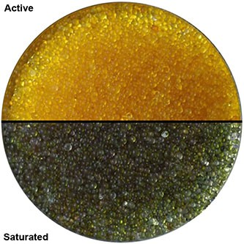
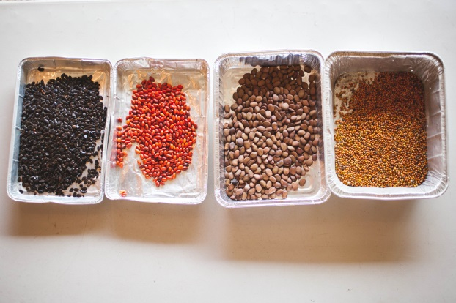
Measuring dryness
Field hygrometer
Electronic Hygrometer
Indicator silica gel
Yellow = dry
(<20-25% RH)
Yellow = dry
Green = wet
Green = wet (>20-25% RH)

Slide 20
If nothing else remember that:
dry seed is the key to good storage

Slide 21
Storage
Seeds should be banked as soon as possible after drying to equilibrium with 15% RH + 3%
Collections should be held in air tight containers
Collections are stored at -20C + 3C
Collections are duplicated at a geographically-separate facility.

Slide 22
Storage containers
Pros Cons
Tri-laminate foil
Light weight. Can be vacuum sealed to Sharp seed needs to be wrapped in remove air cardboard
Glass
Can use self indicating silica gel to Heavy, breakable, vary in quality
test for leaks
Paper
Not as expensive as the other options Not air tight

Slide 23
Storage containers
Pros Cons
Tri-laminate foil
Vacuum sealing removes air and Sharp seed needs to be wrapped in keeps seed dry cardboard
Glass
Can use self indicating silica gel to Heavy, breakable, vary in quality
test for leaks
Paper
Not as expensive as the other options Not air tight

Slide 24
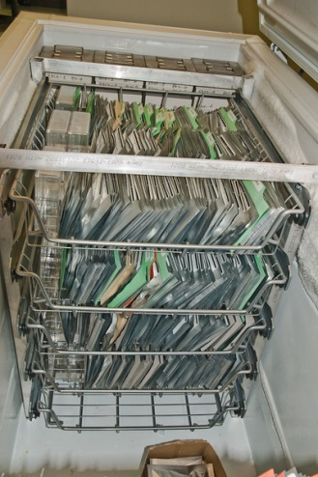
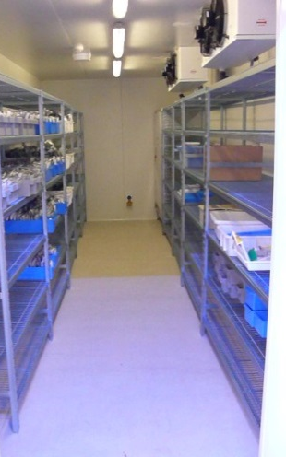
Storage space
Short term/long term?
No. of collections per year.
Container height + width foil or glass jars
Number of containers per collection (small or large seed)
Width of shelving = (0.5M)
Number of years collecting = (Y)
= Freezer or cold room
Freezer Cold room

Slide 25
End of Module Four (Post Collection)
Why not try the quick quiz?
Then, go to Module Five (Germination and Dormancy)

