Slide 1
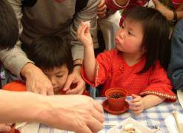
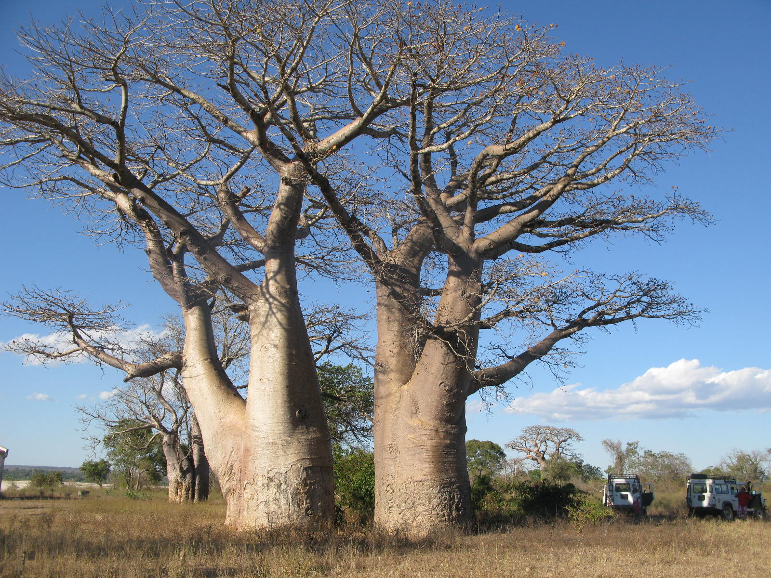
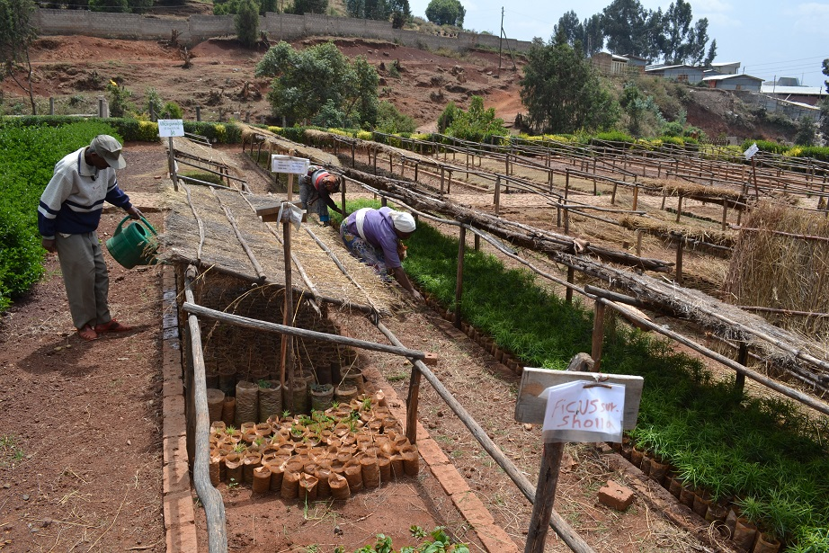
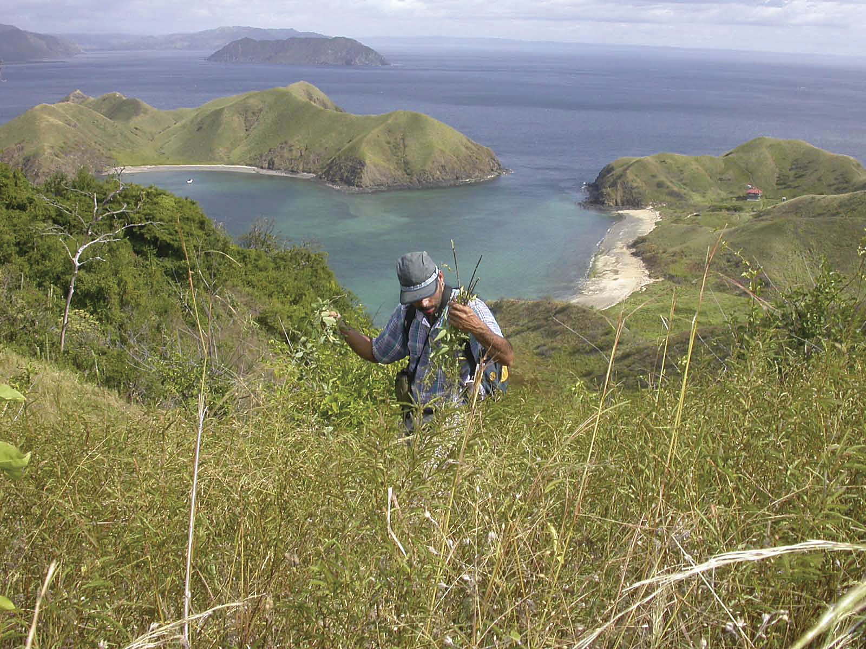
Module 3: Seed Collection
People
Plants
Places
Science

Slide 2
Sampling strategy
Handling
Field data
Herbarium voucher
Post harvest handling

Slide 3
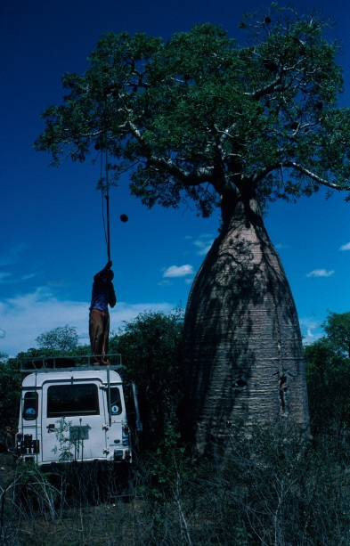
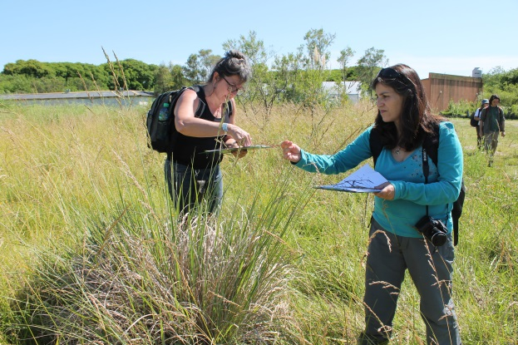
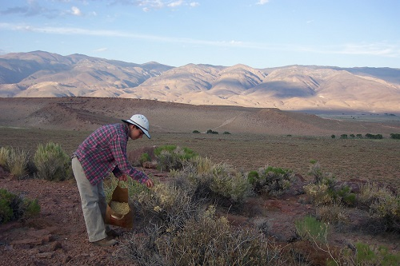
Sampling strategy
Aim: Maximise the quality of the seed collection, making the most of the time and the resources available.

Slide 4
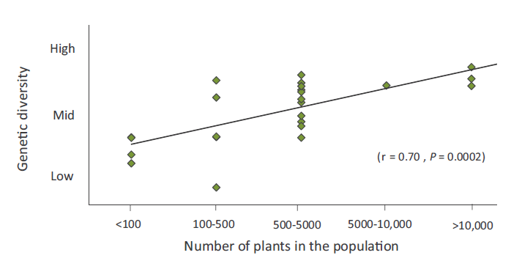
Sampling strategy
Sample large populations
Genetic diversity increases with population size

Slide 5
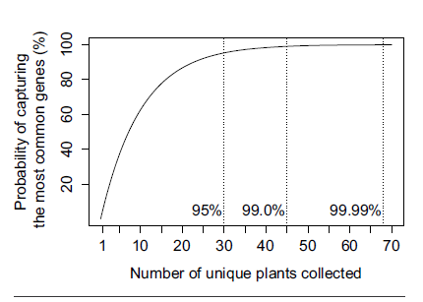
Genetic diversity
Outcrossing species
45 individuals are required for 99% of the most common genes
The likelihood of capturing all but the rarest forms of genetic diversity increases with the number of plants collected. Adapted from Basey et al. 2015

Slide 6
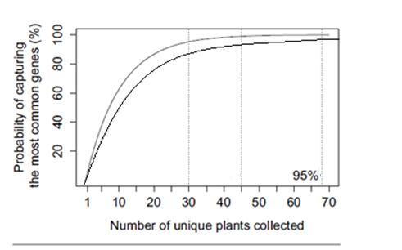
Genetic diversity
Inbreeding species
60 individuals are required for 95% of the most common genes
The likelihood of capturing all but the rarest forms of genetic diversity increases with the number of plants collected. Adapted from Basey et al. 2015

Slide 7
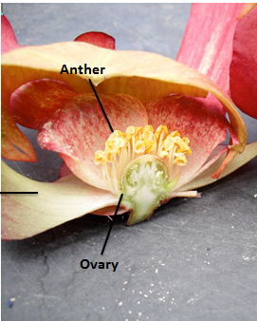
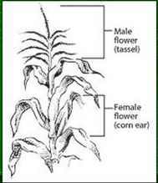
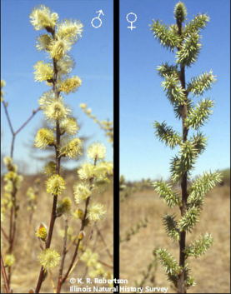
Inbreeding or outbreeding?
Hermaphroditic can in/outbreed
Monoecious can in/outbreed
Dioecious can only outbreed
Difficult to know whether plants are inbreeding or outbreeding
Collectors are advised to sample from a minimum of 50 individuals from within a single population

Slide 8

Sampling Strategy
Collect randomly and evenly in a uniform way across all sectors of the population
8
9
2
3
7
1
11
6
10
5
12
4
14
13
15

Slide 9
Collection summary
Collect
From large populations - the more individuals the more genetic diversity present
Randomly and evenly
Many individuals - A minimum of 50 individuals
Collect from multiple populations

Slide 10
Additional tips to maximise diversity
Sampling should be random – collect from plants throughout the site, including (wherever possible) difficult to access areas, edges and microclimates.
Don’t avoid less robust looking individuals or plants that look different and have unique growth forms
Do avoid collecting clones and siblings – don’t sample from plants that are close together

Slide 11
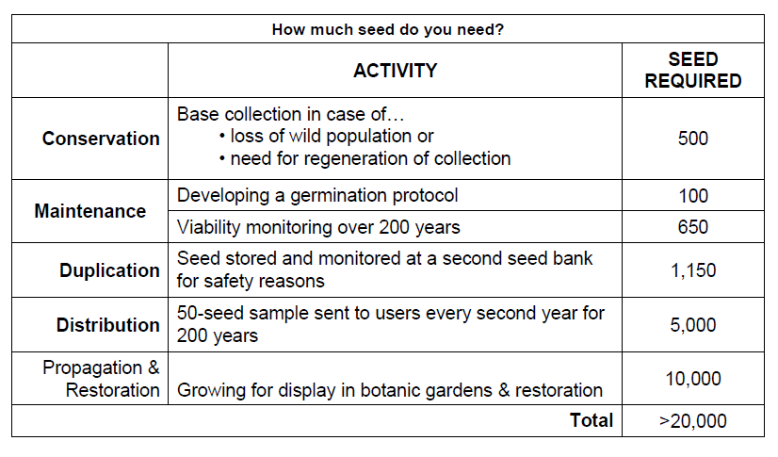
Quantity

Slide 12
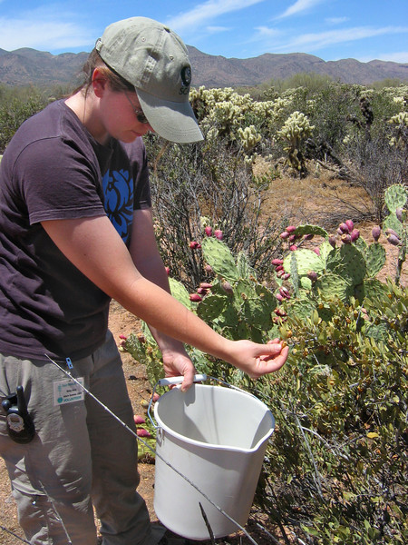
Seed collection
Hand picking of whole fruits
Used for shrubs, herbs and low hanging trees
Damaged/immature fruit can be excluded from the collection
Collecting vessels can be tied to the waist of the collector to allow for more efficient collecting
Time consuming for large collections

Slide 13
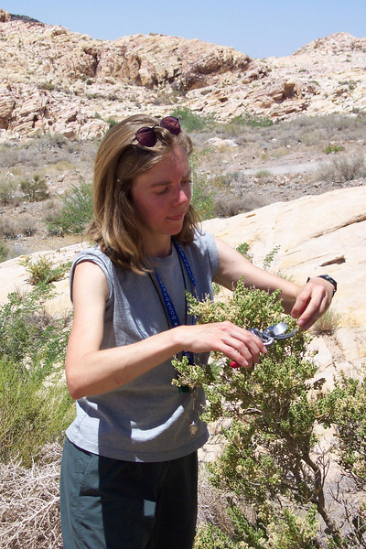
Seed collection
Pruning clusters of fruit
Used for shrubs and trees
Secateurs or tree pruners can be used to collect clusters of fruit within reach and also out of reach.
Seeds can be assessed for quality before being added to the collection.

Slide 14
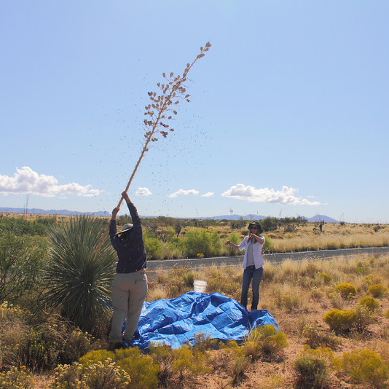
Seed collection
Shaking branches
Used for trees
Seed can be collected by tarpaulin or buckets
Light shaking can dislodge ripe seed ready to disperse
Care should be taken not to damage the plant or collector
Light seed may be carried away by the wind.

Slide 15
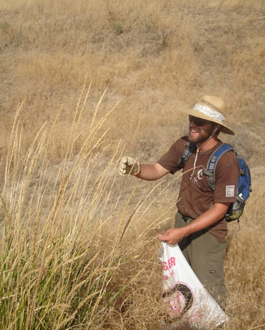
Seed collection
Stripping entire seed heads
Used for grasses and species with seed heads
Effective if fruit is loosely held on stem
Gloves may be required

Slide 16
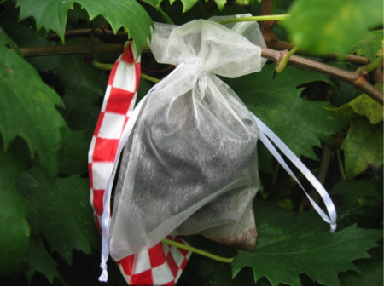
Seed collection
Bagging seed heads
Used for seed that would be lost otherwise
Can be used when frequent access to the site is available
Mesh bag is placed over the fruit and seed is captured as soon as they are shed.
Contents can be removed at intervals. Seed will always be collected at natural dispersal

Slide 17
Post-harvest handling
Starts in the field immediately following collection
Collect into buckets, cloth or paper bags
Keep seeds cool and dry
Seed/fruit left in a vehicle will overheat
High temperatures can reduce viability
Maintain ventilation
Spread damp seed to aid drying
Transport seed as fast as possible to the processing and storage facility

Slide 18
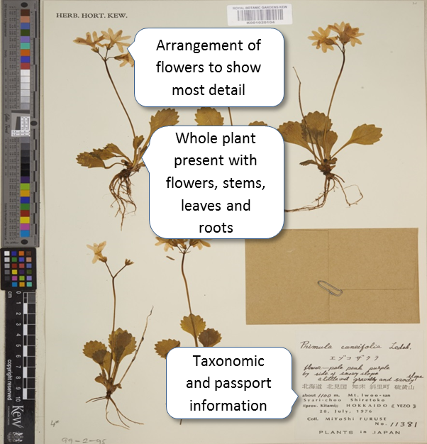
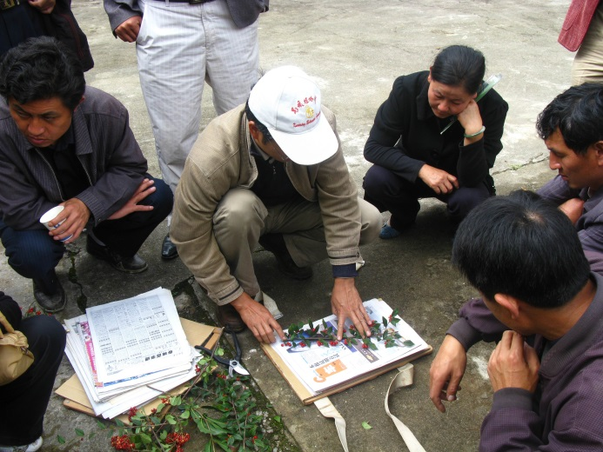
Herbarium specimen
Essential for identification of the species.
Should be linked to the seed collection.
Ideally include all distinguishing features
Flower/fruit
fruiting structure
vegetative material
Specimens should be dried and pressed
Mounted herbarium specimen.
© The Board of Trustees of the RBG, Kew http://specimens.kew.org/herbarium/K001020104

Slide 19
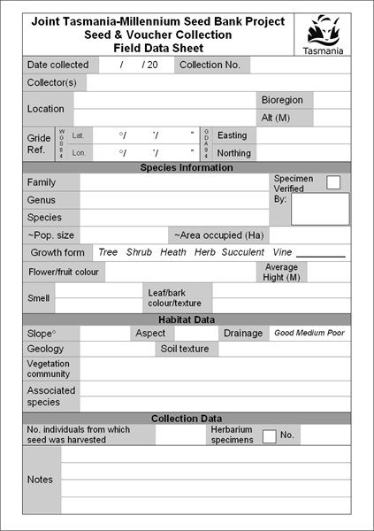
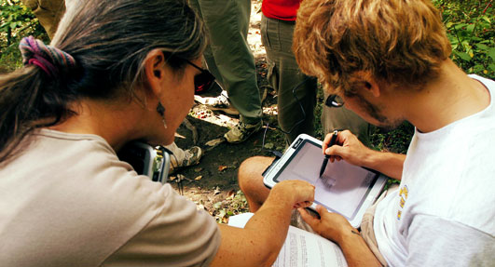
Data collection in the field

Slide 20
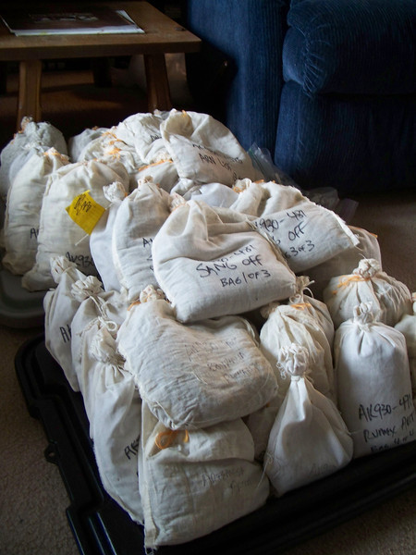
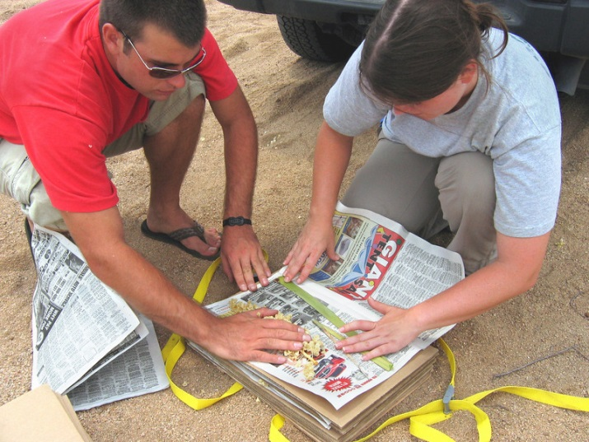
Labelling- seed is useless without it!
Linking data
Species name if known
Collection No./Field No.
Date

Slide 21
End of Module Three (Seed Collection)
Why not try the quick quiz?
Then, go to Module Four (Post Collection)

