Slide 1
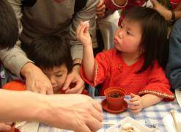
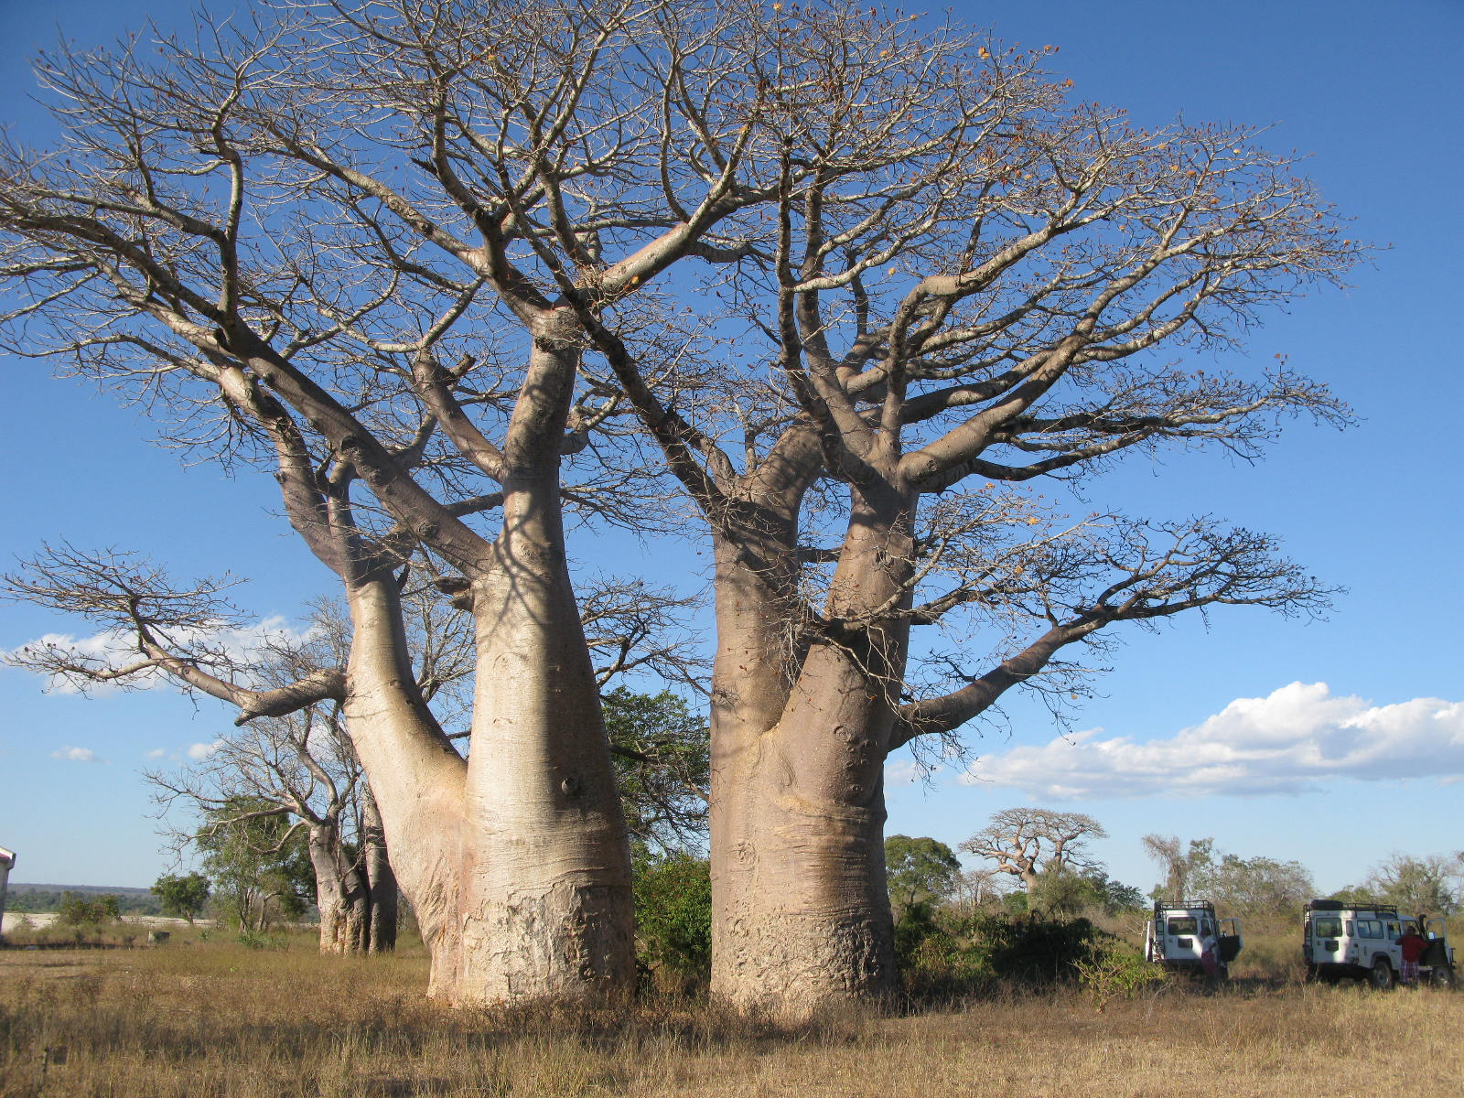
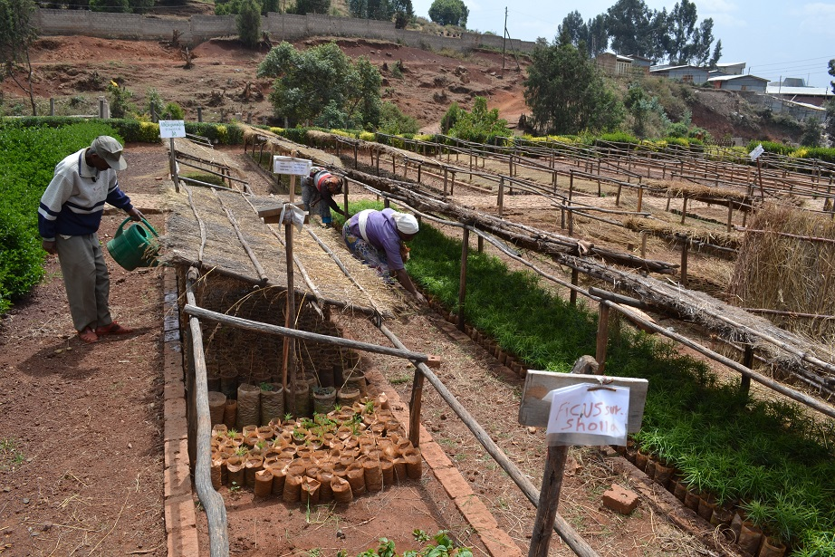
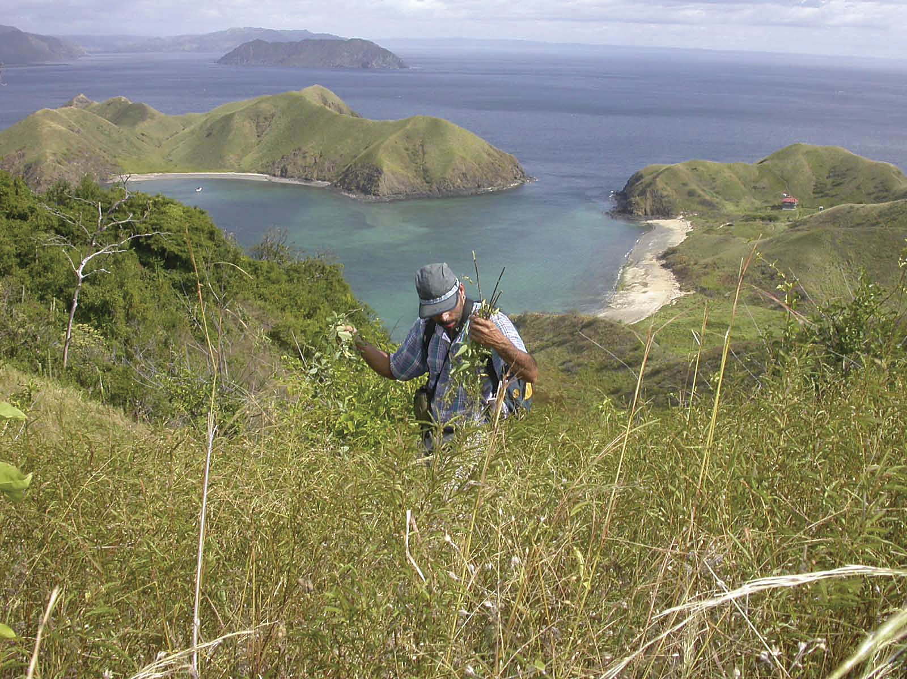
Module 2: Prioritisation and Pre-collection Assessment
People
Plants
Places
Science

Slide 2
Why plan
Prioritisation
Prospecting
What, where, when, how
Quantity
Quality

Slide 3
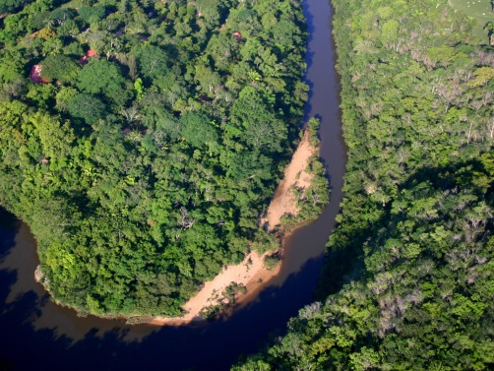
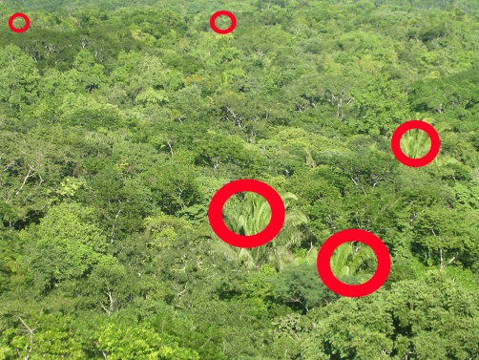

Why plan?
Be in the right place at the right time and collect quickly and efficiently.
Especially important when collecting:
in inaccessible, multispecific natural forests
from different sources and widely spread species
within different countries with differing regulations

Slide 4
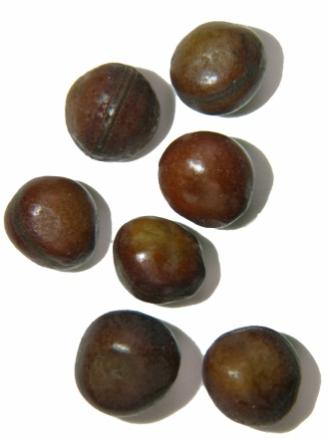
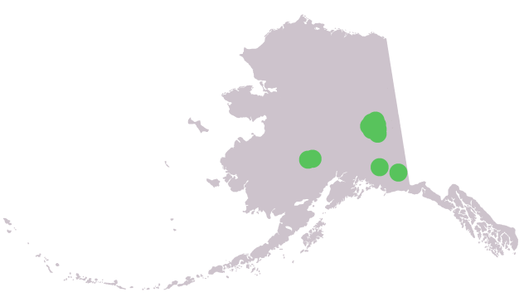
Prioritisation
Decide on the species to collect and then look for a location.
Decide on the sites and identify species to collect.
OR

Slide 5

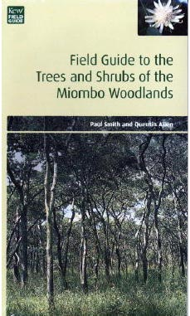
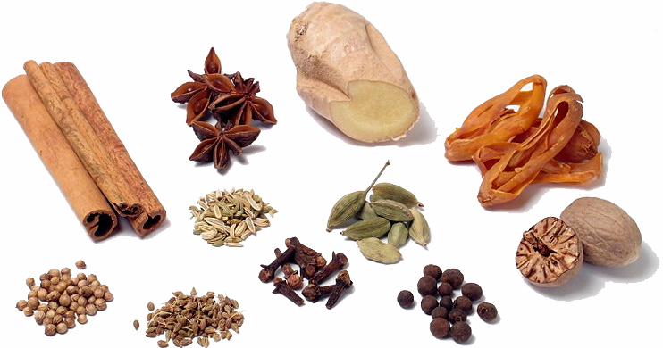
Prioritisation
Species prioritised depends on national and institutional goals.
e.g.
Millennium Seed Bank Project
The three E’s:
Endangered species: Critically Endangered, Endangered or Vulnerable species or habitats Endemic species: Species native to an area, and neither introduced nor a pan-tropical weed
Economic species: Species valued/used by people

Slide 6
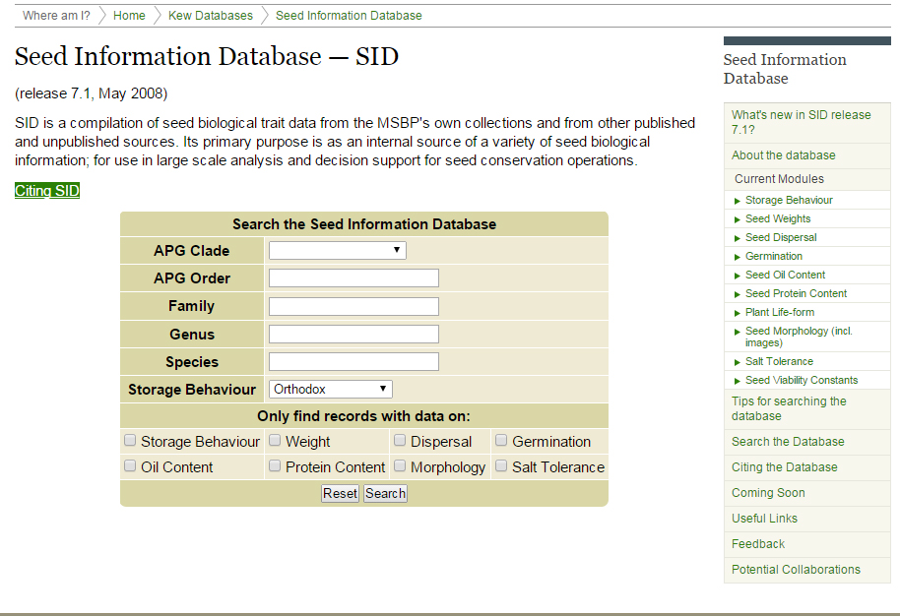
Prioritisation
Other criteria for prioritising can include:
Orthodox seeds: retain viability after drying and freezing
Species required for research
Rare seeds: not already banked or readily available
http://data.kew.org/sid/

Slide 7
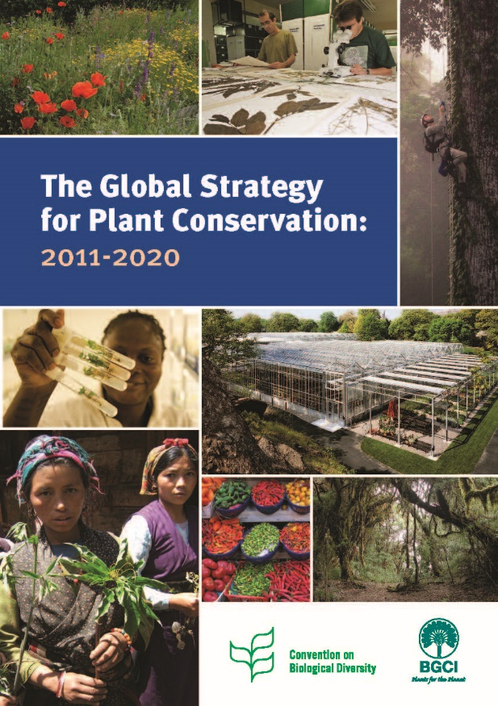
Prioritisation
Target 8 of GSPC:
“At least 75 per cent of threatened plant species in ex situ collections, preferably in the country of origin, and at least 20 per cent available for recovery and restoration programmes.”
https://www.bgci.org/policy/gspc/

Slide 8

Prioritisation
Over 400 botanic gardens are involved in seed banking. The GSCC will increase the contribution of the botanic garden community towards Target 8 of the GPSC through training, prioritisation, prizes and sharing knowledge.
https://www.bgci.org/plant-conservation/seedconservation/

Slide 9
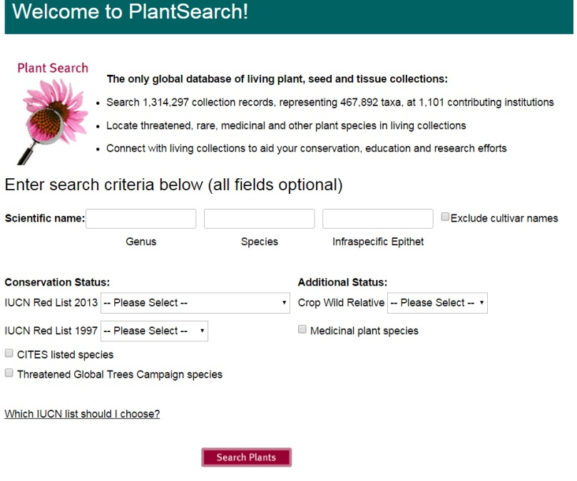
Prioritisation
Sharing data helps to prioritise seed collection
e.g.
PlantSearch
Global database of plant species in botanic gardens and similar organizations including taxon-level data on seed bank collections.
Used to measure progress toward Target 8 of the GSPC
https://www.bgci.org/plant_search.php

Slide 10
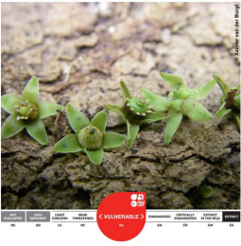
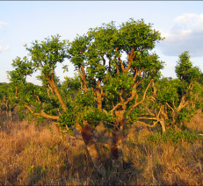
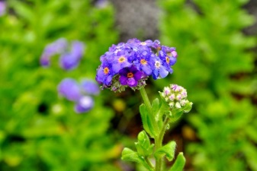
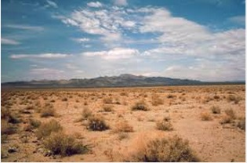
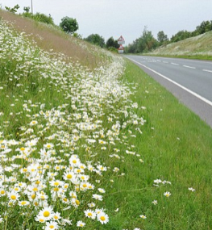
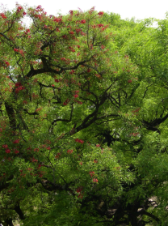
Prospecting
The target species
What is it?
Where will you find it?
Threatened | Useful | Endemic
Desert | Roadside | Forest

Slide 11
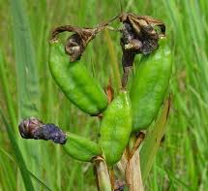
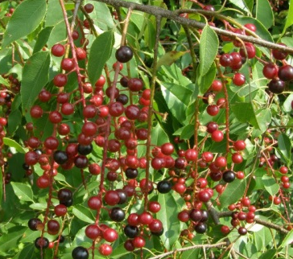
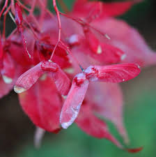
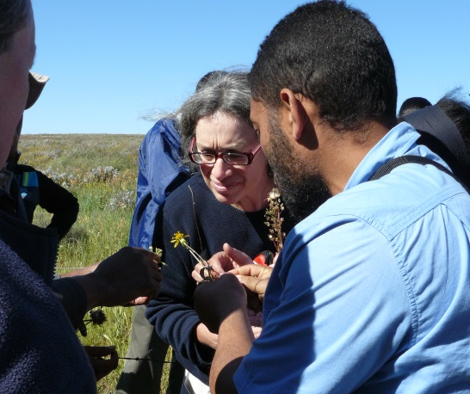
When will it fruit? Spring, Summer, Autumn
Can you identify it?
Spring | Summer | Autumn

Slide 12
Resources
Nomenclature - Plant List, Tropicos, IPNI
Location: IUCN, Red Lists, GBIF, checklists, Herbarium specimens
Phenology: Herbarium specimens, Pep725
Identification: Monographs, Floras, Biodiversity Heritage Library, Herbarium specimens
Threat Status: IUCN Red List, National Red Lists

Slide 13

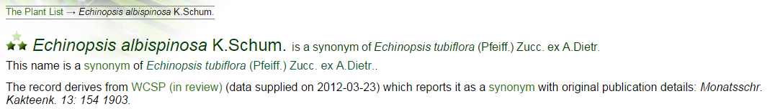

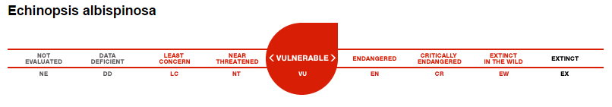

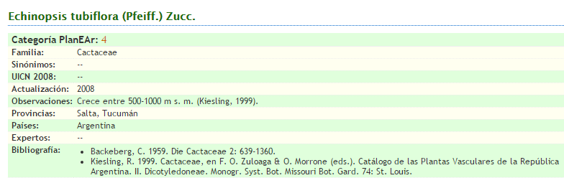
What is it?
The target species – Echinopsis albispinosa K.Schum.
Synonym: Different name for same species
Information under accepted name
Threatened
Endemic

Slide 14
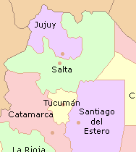
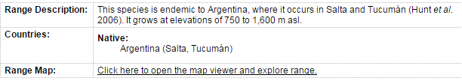

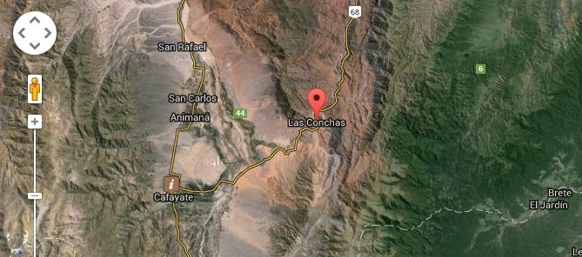
Where will you find it?
The target species – Echinopsis albispinosa K.Schum.
Location
More information
Elevation

Slide 15
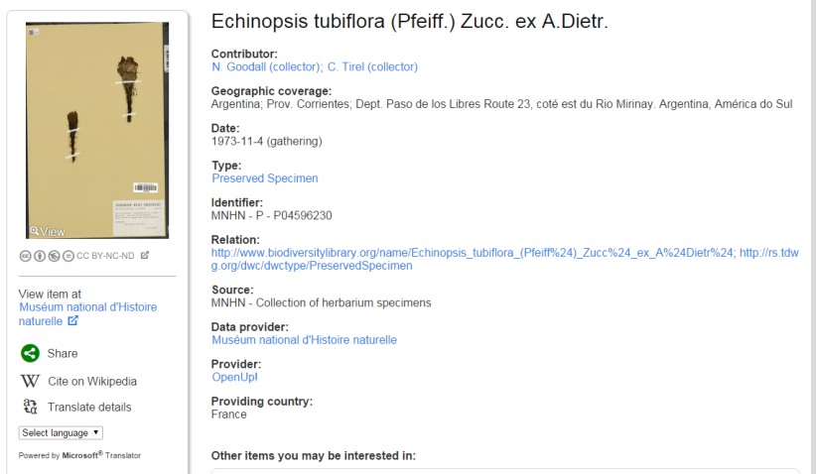
When will it fruit?
The target species – Echinopsis albispinosa K.Schum
Herbarium specimen, Floras
In flower
Date collected

Slide 16
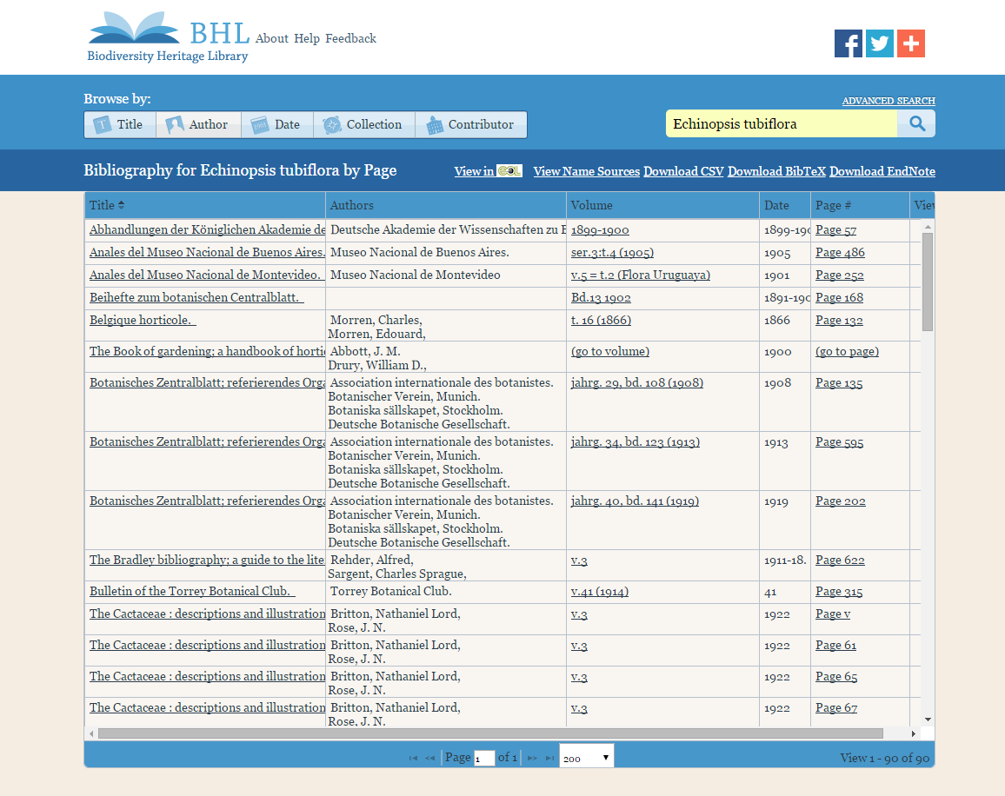
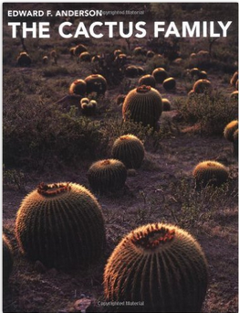

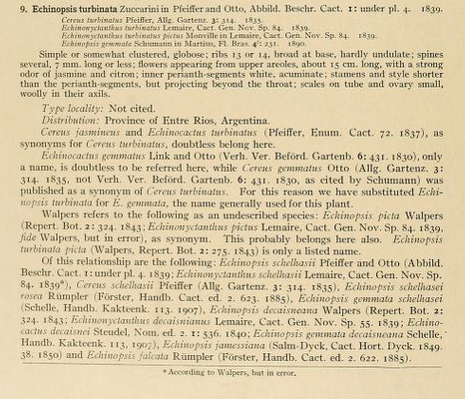
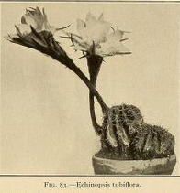
Can you identify the species?
Species description

Slide 17
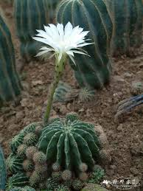
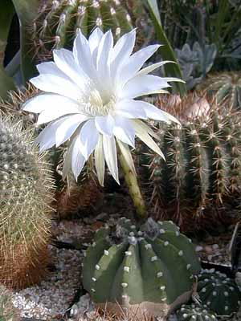
Can you identify the species?
Crucial- don’t mix up species in same genus.
Several spines
No spines
Echinopsis tubiflora
Echinopsis subdenudatus

Slide 18
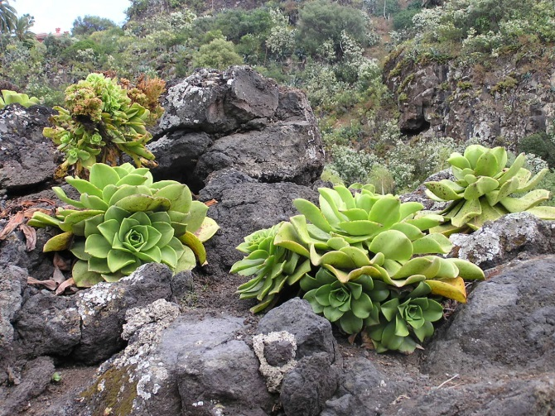
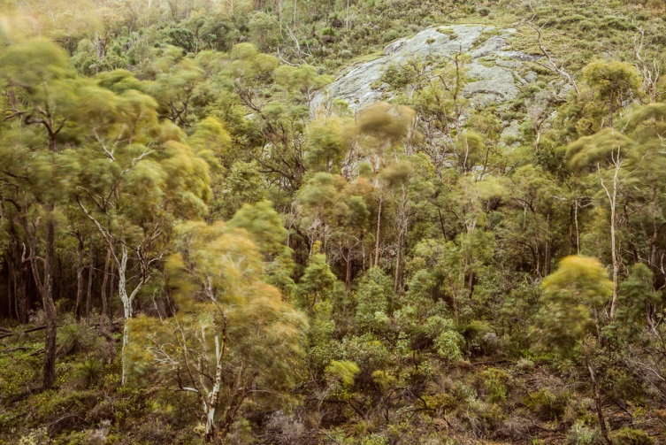
Can you identify the population?
What is a population?
- a group of individuals, capable of interbreeding, that occupy a defined geographic area.
- populations will look different for different species.

Slide 19
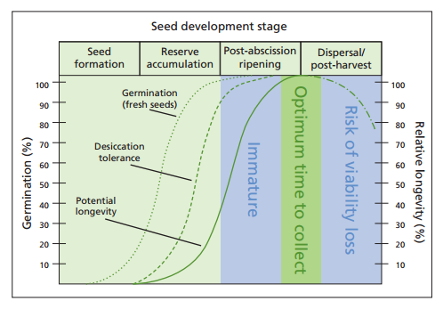
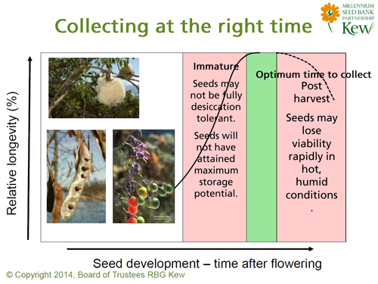
Quality
Aim: To collect healthy seed. Collect seed when it is ready

Slide 20
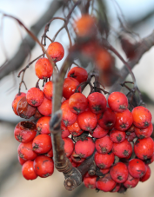
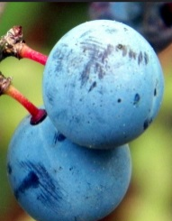
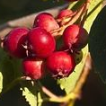
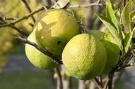
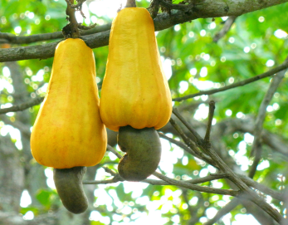
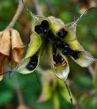
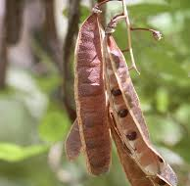
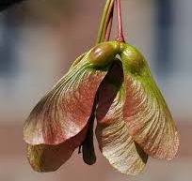
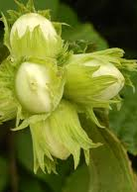
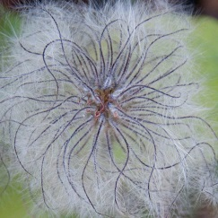







Quality
Berry | Drupe | Pome | Hesperidium | Pseudocarp | Follicle | Legume | Samara
Nut | Achene | Hip | Utricle | Cypsela | Capsule | Silique | Syconium | Lomentum
Different types of fruit display ripeness in different ways

Slide 21






Quality
Changes in fruit colour
Splitting of fruit
Some seeds are already dispersed
Fruit and seed hard and dry

Slide 22

Quality
Determining physical quality of the seeds
Empty/insect damage/immature/deformed
‘Cut test’
Aim to collect healthy seed
Cut open ~ 10 seeds from several well spaced individuals in the population
If seeds are small use adhesive tape to hold them during sectioning.
Use a hand lens to view if seeds are small

Slide 23

Quantity

Slide 24
Quantity
Collection plan
From at least 50 individuals per population
As many populations as possible
Collect no more than 20% of mature seed available on the day of collection
Ideally >10-20,000 viable seeds
Aim to collect a large sample

Slide 25

Pre-collection checklist

Slide 26
End of Module Two (Prioritisation and Pre-collection Assessment)
Why not try the quick quiz?
Then, go to Module Three (Seed Collection)

