Slide 1
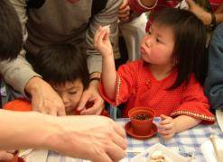
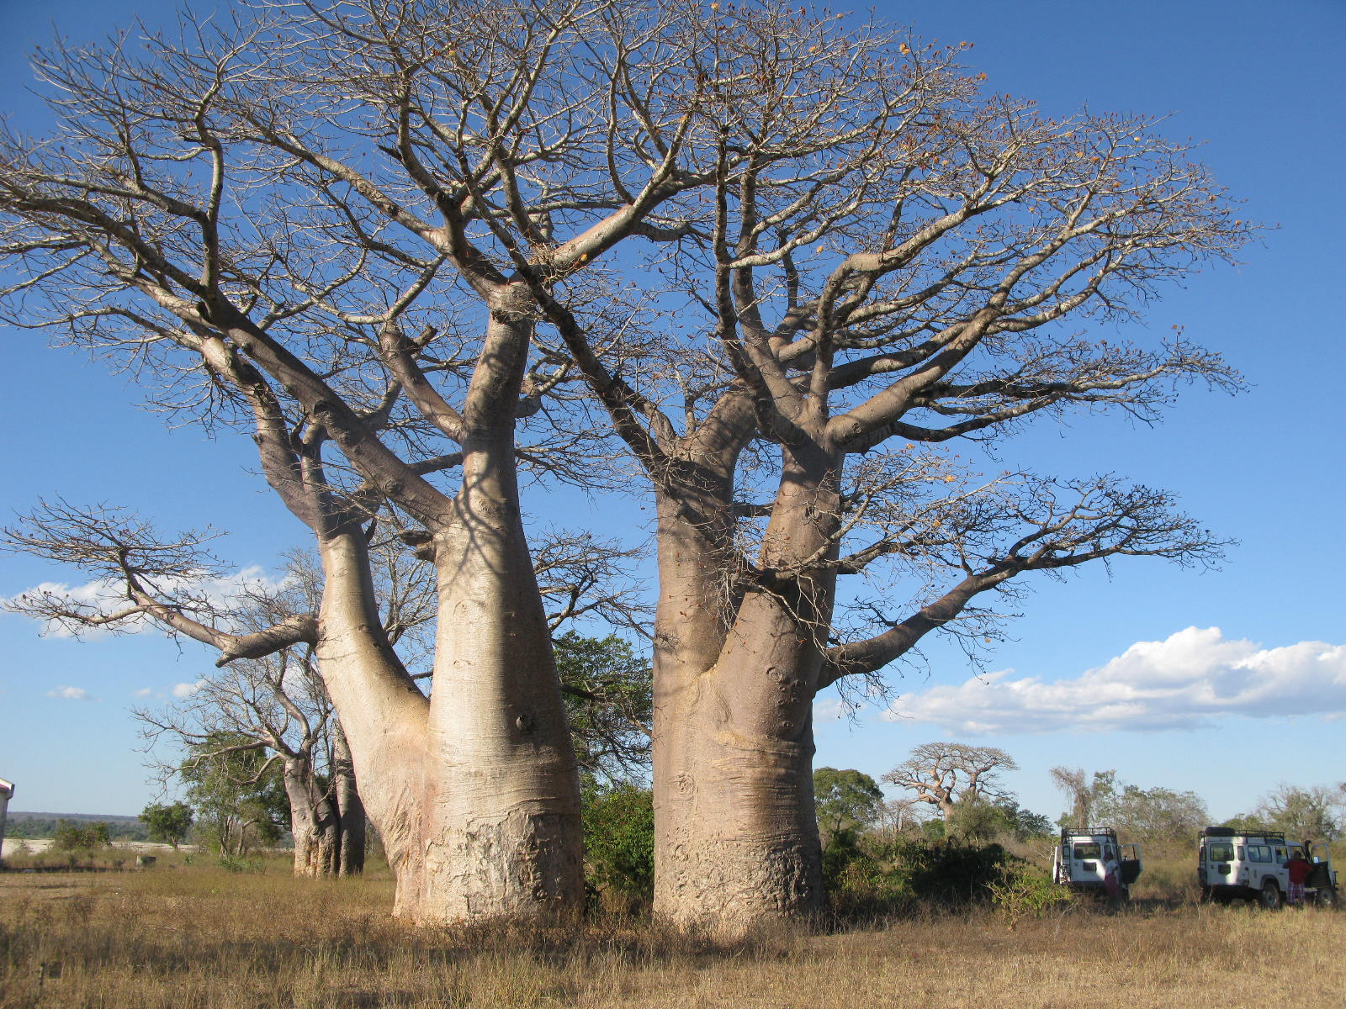
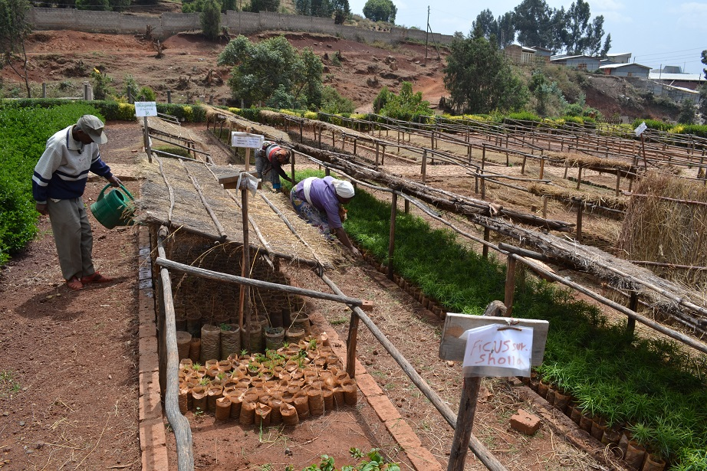
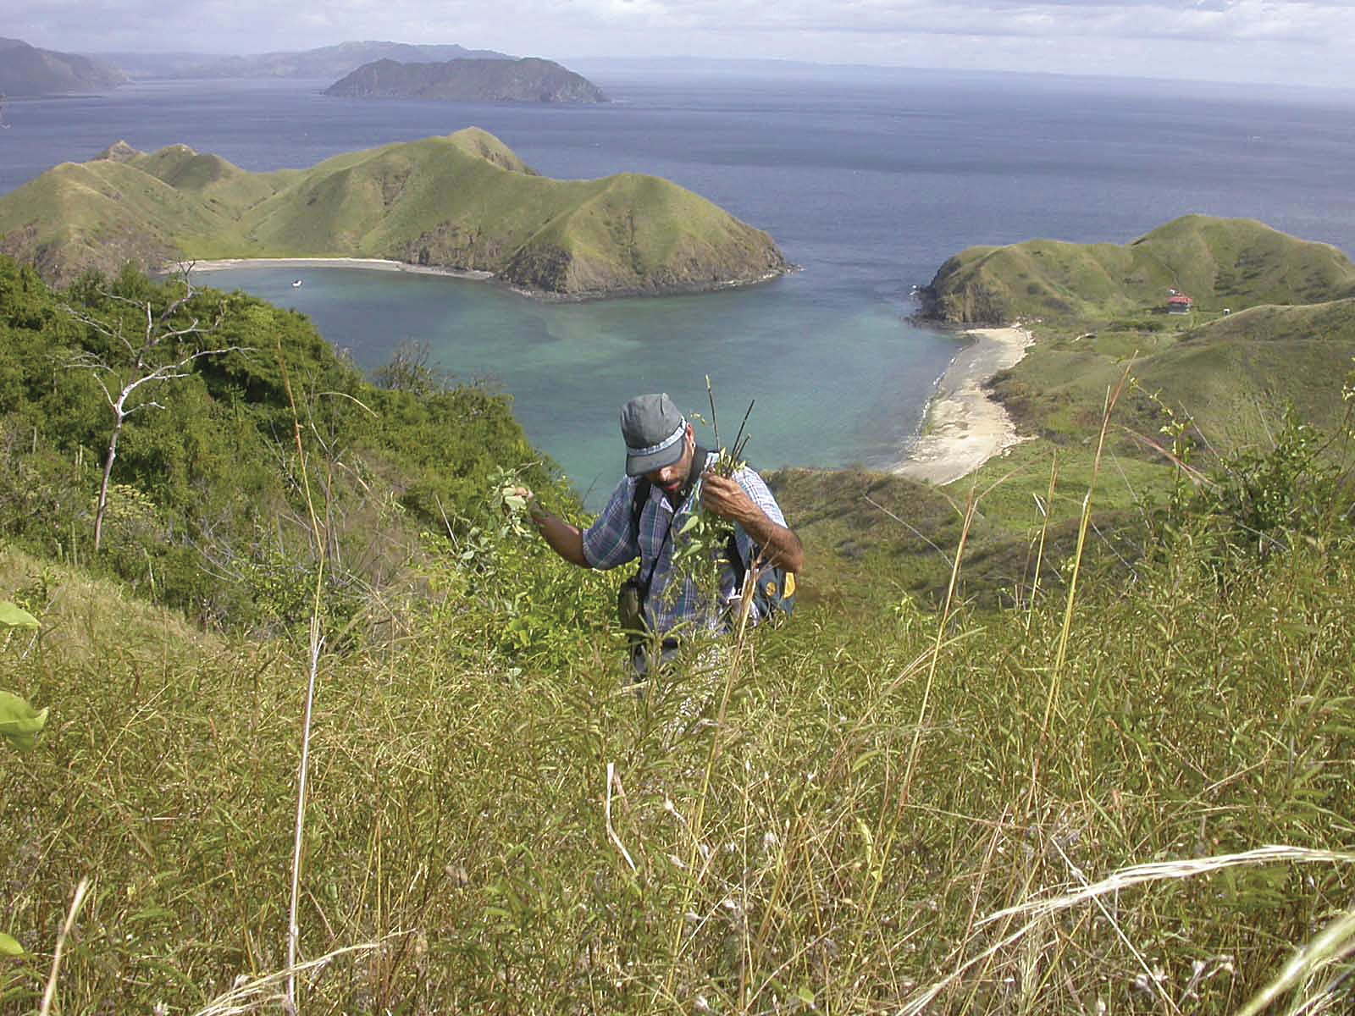
Module 1: Planning a Collection
People
Plants
Places
Science

Slide 2
Permission
Logistics
Safety
Your team
Equipment

Slide 3

Permission
Ensure collecting is done legally
seek permission from landowners and managers before collecting seed.
Collecting from rare or threatened species, protected areas, or countries rich in biodiversity? A collecting permit is a legal requirement.

Slide 4

Permission
Failure to obtain the required documents can delay operations, jeopardize future efforts or result in prosecution!

Slide 5




Permission
Check target species are not protected
e.g.
CITES
http://www.cites.org
e.g.
The Bern Convention
http://conventions.coe.int/Treaty/EN/Treaties/Html/104.htm
e.g.
National Protected Species

Slide 6
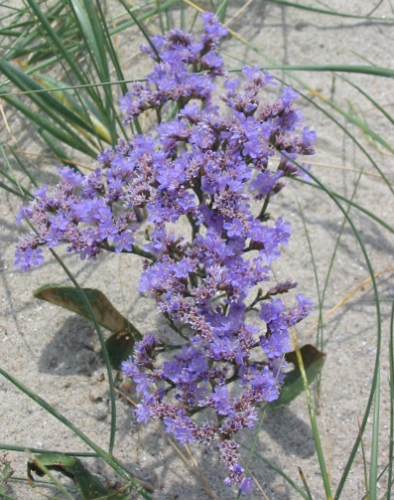
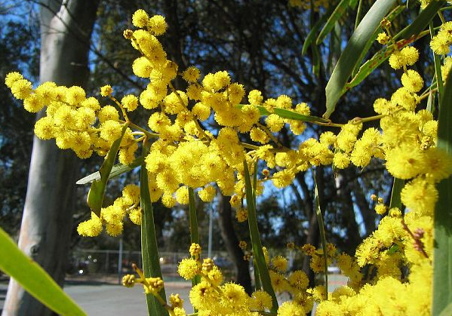
Permission
Rules differ depending on country and who owns the land.
e.g.
UK
Collecting species included in Schedule 8 of Wildlife and Countryside act (1981) requires a
specific permit from
the relevant statutory
conservation agencies:
Natural England,
Natural Resources
Wales or Scottish
Natural Heritage
e.g.
Australia
permission from traditional landowners may be required as some plants can have special significance and cannot be touched (e.g. totemic plants)
Take advice from local collaborators, government offices, and biologists.
Contacts: http://www.cbd.int/information/nfp.shtml

Slide 7
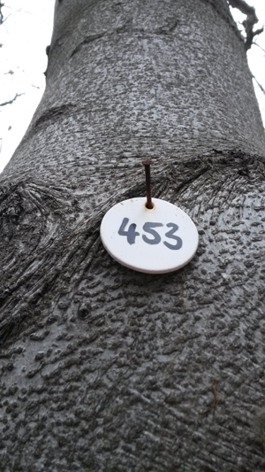
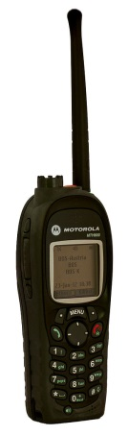
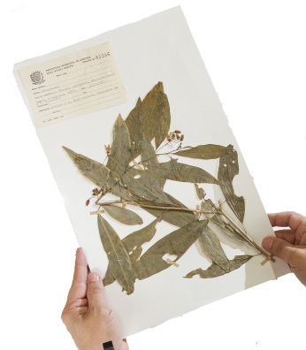
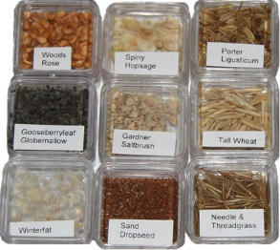
Permission
You may need permission for:
Tagging trees
Seeds and herbarium specimens
Restricted equipment

Slide 8

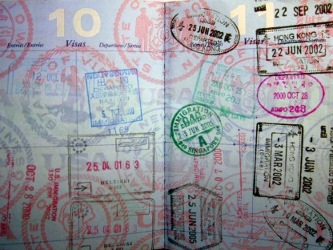
Permission
Things to consider:
Access: Liaise with local site management.
Insurance e.g. health and safety assessments.
Personal documentation e.g. entry visas, work
permits and international health certificates.
Specimens for a national institution may be a condition of permission
Contact the national plant health authorities if seeds are to be moved to other countries

Slide 9
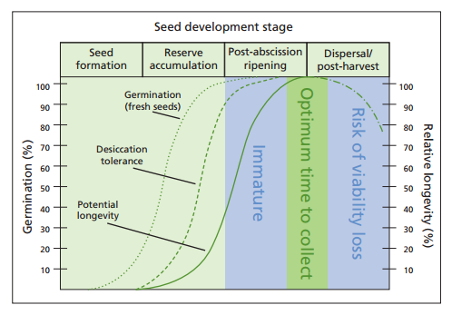
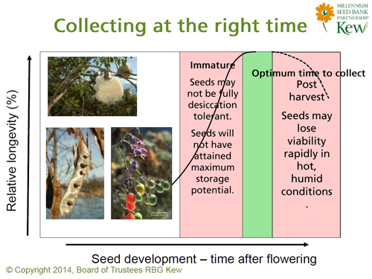
Logistics: Timing
Collect at point of seed dispersal to maximise longevity in storage

Slide 10

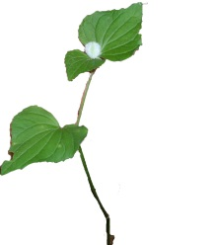

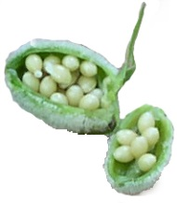
Logistics: Timing
Phenology:
Varies between species and years depending on weather and other factors. Herbarium data only an estimate.
e.g.
“… in the case of NW European herbaceous species, an extra 1.5-2 months is a useful guide for the time between peak flowering and peak seeding…” (ENSCONET, 2009)

Slide 11
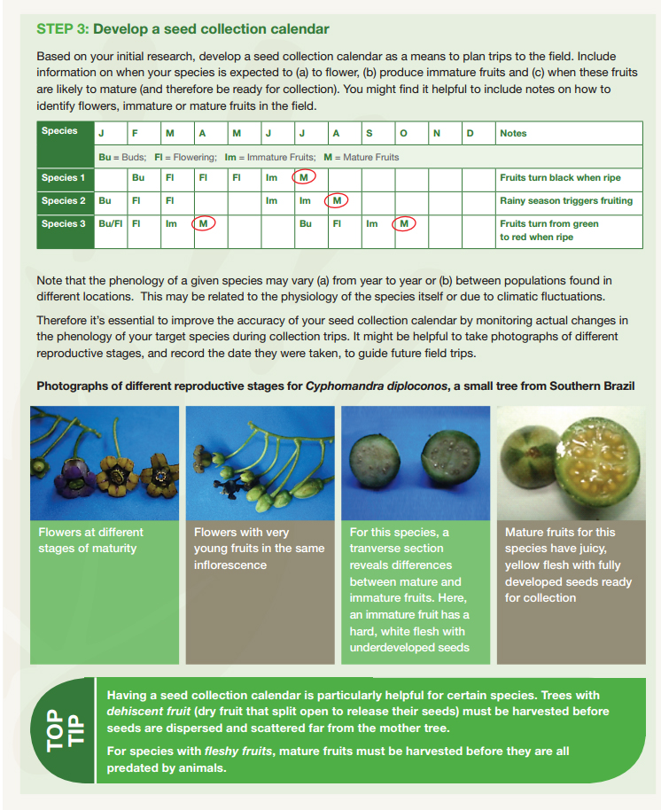
Logistics: Timing
An up-to-date seed collection calendar helps plan trips.
(Global Trees Campaign, 2013)

Slide 12
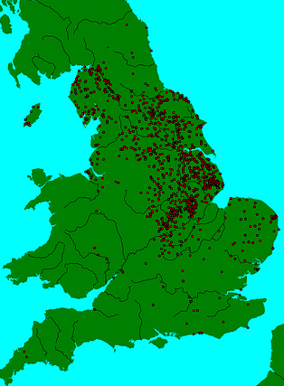
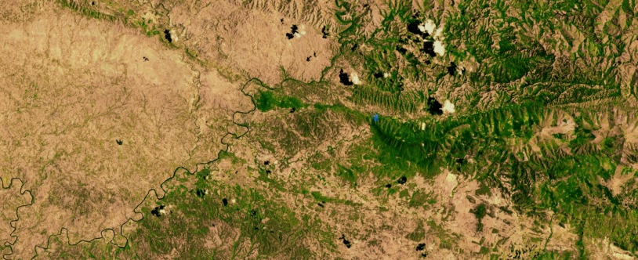
Logistics: Location
Research:
local botanists and plant ecologists
Eco-geographic surveys
Inventories
Distribution maps in floras
Chronological accounts in botanical journals
Herbarium sheets
Reconnaissance trips and surveys
satellite vegetation imagery

Slide 13
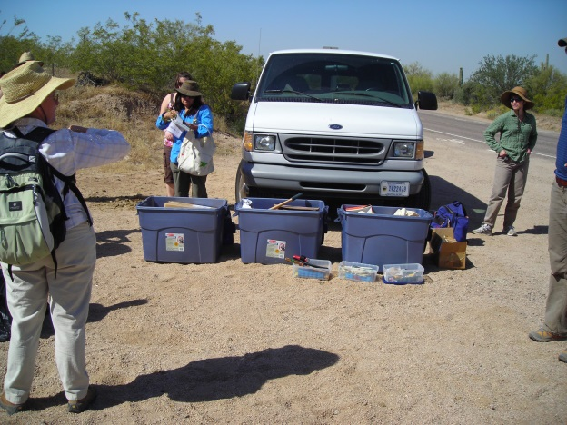
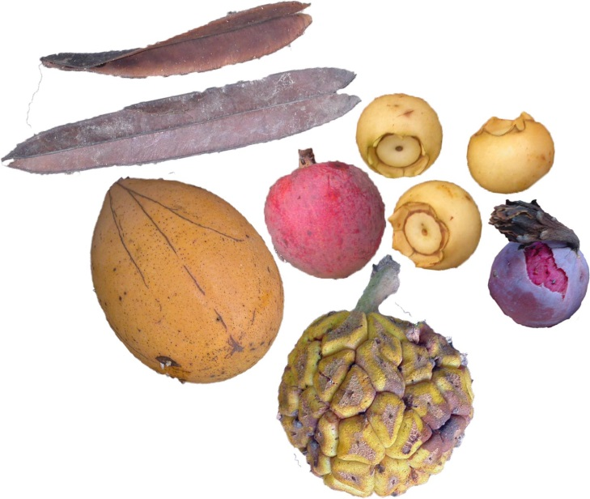
Logistics: transport
Plan ahead!
Rapid movement of fruits from collection site might be needed.
Advise seed extractory staff when to expect fruits.
Don’t waste time!
Ensure enough vehicles
are available/hired and
routes are passible.

Slide 14

Safety
Protocol:
Insurance relevant to conditions you will face (terrain and weather)
Follow bio-security and plant health procedures to prevent the spread of pathogens
Be familiar with your occupational health and safety policies

Slide 15
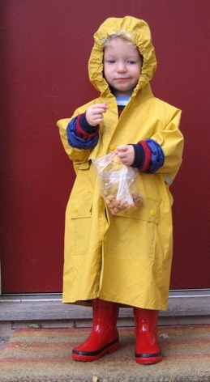


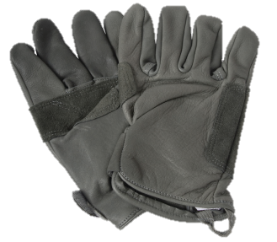
Safety
Your equipment:
Appropriate clothing and personal protective equipment
Plenty of water for drinking and washing hands (especially if handling poisonous or irritating seeds)
Check all safety equipment before you leave

Slide 16

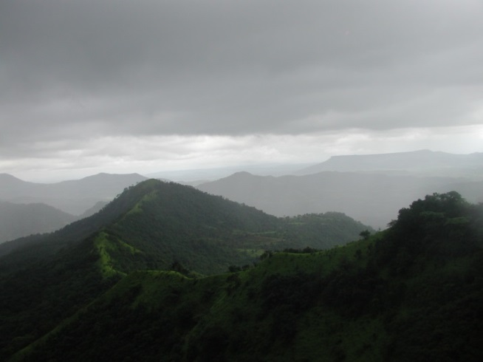
Safety
Plan ahead:
Give your itinerary to someone who will take action if regular pre-arranged contact is lost.
Don’t go into the field with fewer than three people
Check weather, road and fire reports
Make contingency plans
Carry appropriate telephone numbers

Slide 17
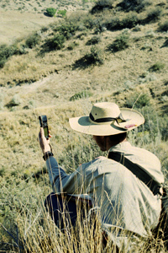
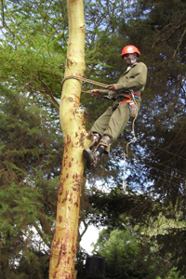
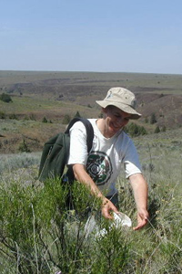
Your team
Ensure you have the right people for the job
e.g.
Navigators
Seed collectors
Tree climbers
First aiders

Slide 18
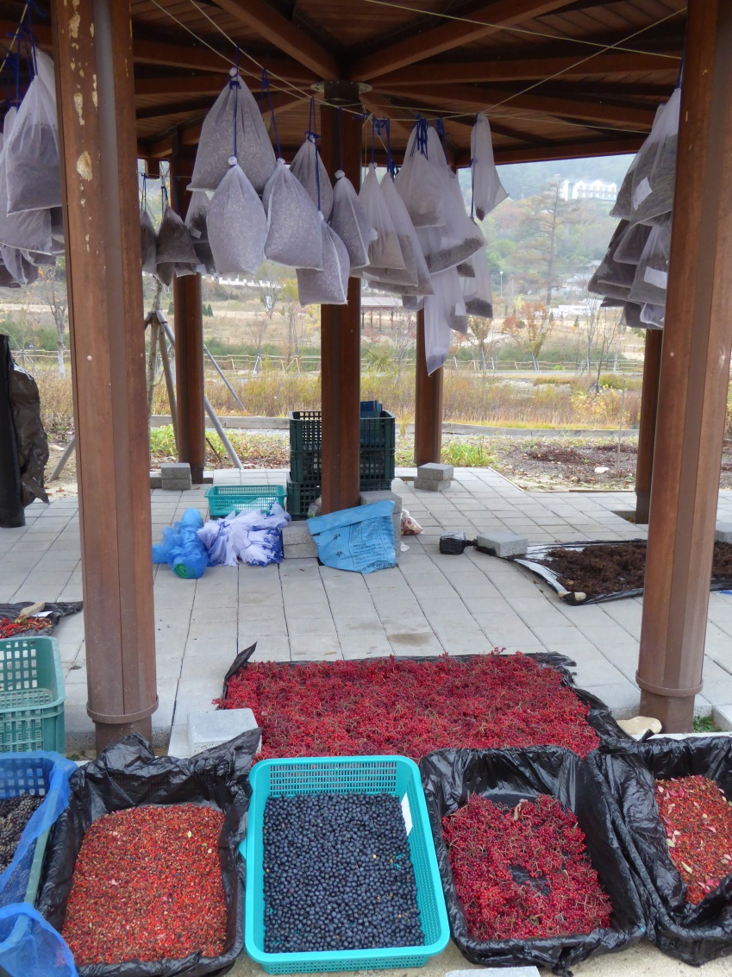
Equipment
Using the correct equipment:
Makes collecting easier
Ensures your seeds will be effectively banked
Prevents accidents

Slide 19
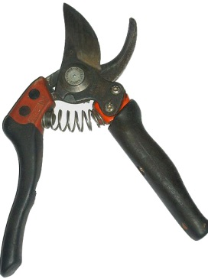
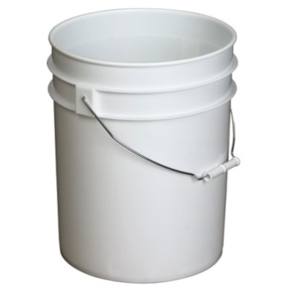
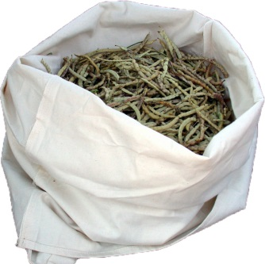
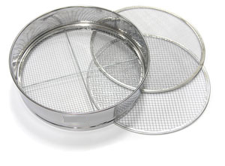

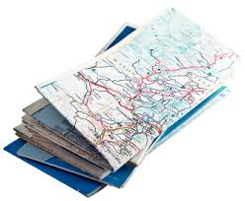
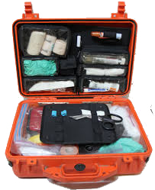
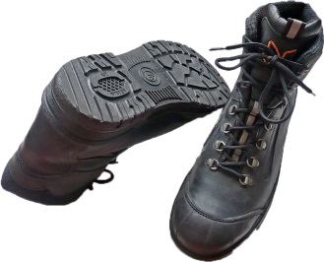
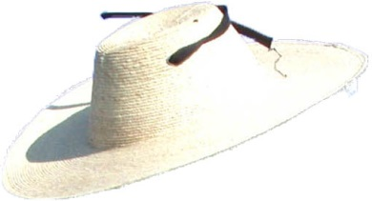
Equipment
Equipment for collecting seed
Equipment for storing seed
Personal Protective Equipment
Safety gear

Slide 20
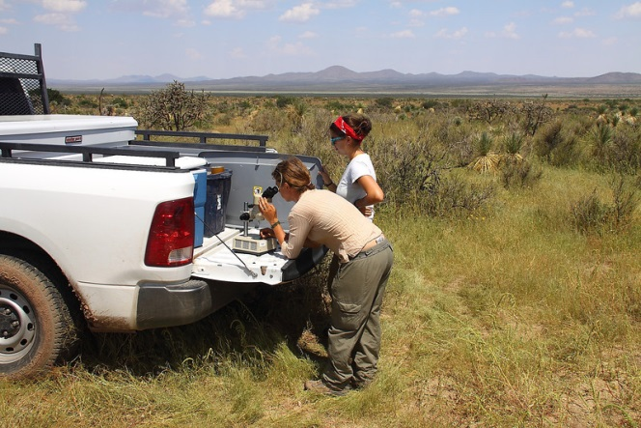
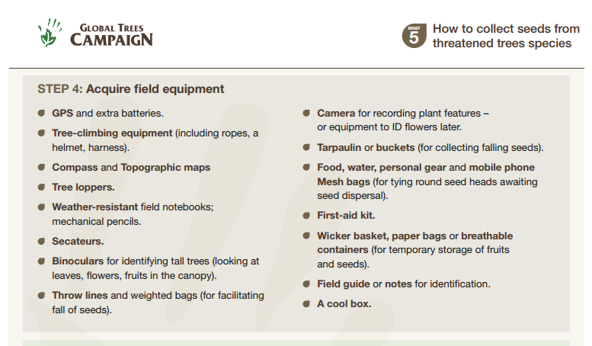
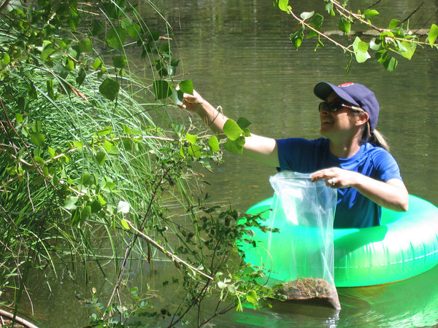
Equipment
Equipment will vary depending on terrain and species of interest.
Equipment lists
Global Trees Campaign, 2013. p.4

Slide 21
End of Module One (Planning a Collection)
Why not try the quick quiz?
Then, go to Module Two (Prioritisation and pre-collection assessment)

