Slide 1
Module 4: CITES and Scientific Institutions
People
Plants
Places
Science

Slide 2
The CITES Register of Scientific Institutions
Under CITES there is a free label scheme that allows movement of CITES material for scientific purposes only between scientific institutions that are registered with CITES.
This is outlined in Resolution Conf. 11.15 (Rev CoP12) as the “non-commercial loan, donation or ‘exchange between scientists or scientific institutions registered by a Management Authority of their State, of herbarium specimens, other preserved, dried or imbedded museums specimens, and live plant material which carry a label issued or approved by a Management Authority”.

Slide 3
Why was this scheme set up?
Parties recognised that the need of museums and institutions to obtain research specimens could have a detrimental impact on small populations of rare plants and animals.
They also recognised that such research could help in the conservation of these small populations and that this should be encouraged and facilitated.
Inventorying collections and making this information publicly available would enable decisions to be made on whether further collecting of rare specimens was necessary, or whether the material needed could be borrowed from another institution.

Slide 4
How does this scheme work?
If exchanging CITES material between registered institutions:
A FREE LABEL SCHEME CAN BE USED.
If exchanging CITES material with an institution that is not registered: FULL CITES PERMITS ARE REQUIRED. This includes live plants and herbarium specimens.

Slide 5
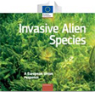
How does this scheme work?
If a species is not listed on CITES, a CITES permit is not needed. Other issues may then need to be considered, for example the Convention on Biological Diversity, the Habitats Directive, Plant Health legislation or other relevant legislation or agreements concerning the movement of plants.

Slide 6
How does this scheme work?
Your institution must become registered with your Management Authority (MA) and the CITES Secretariat.
You will then obtain a unique 5-digit CITES registration number e.g.
RBG Kew, UK - GB 005
Forest Research institution, Malaysia - MY 001
The institution to which you send or exchange CITES-listed specimens must also be registered and have their own unique CITES registration number.

Slide 7
Some Criteria for Registration
Resolution Conf. 11.15 (Rev. CoP12) for full list
Collections of animals or plant specimens, and records ancillary to them, permanently housed and professionally curated;
Specimens accessible to all qualified users, including those from other institutions;
All accessions properly recorded in a permanent catalogue;

Slide 8
Some Criteria for Registration
Resolution Conf. 11.15 (Rev. CoP12) for full list
Permanent records maintained for loans and transfers to other institutions;
Accurate data maintained on specimen labels, permanent catalogues and other records;
Acquisition and possession of specimens accord with the laws of the State in which the institution is located.

Slide 9
How do I register?
Contact your MA and request registration giving them the details of your institution, its size, scope of collections, their management and some general details on how you keep your records.
Provide as much information as possible to assist your application.
©RBG Kew

Slide 10
How do I register?
Your institution contacts your MA.
The MA contacts the national SA.
The SA confirms they are happy that your institution fulfils the criteria for registration.
The MA contacts the CITES Secretariat informing them that your institution be included in the CITES Register of Scientific institutions.
The CITES Secretariat issues a notification with updates to the CITES Register, including your institution.

Slide 11
How do I register?
In liaison with the CITES Secretariat, the CITES MA will issue you with a unique number to be used in all movement of CITES material under the exemption.
For example, if you are the first institution to be registered in your country, your number might be BN 001.

Slide 12
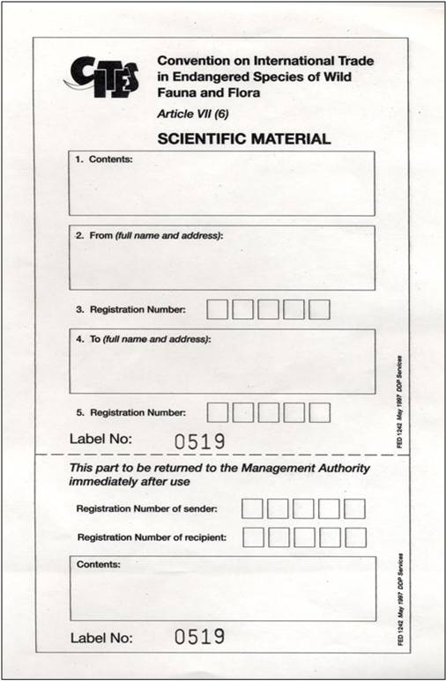
How do I register?
The MA should issue you with a label
that contains the following information:
CITES logo
Your name and address
The name and address of the CITES registered institution to which you are sending the material
Both CITES registration numbers
Details of the material in the package
Attach label to the outside of the
package - Customs don’t have X-ray eyes!
EU label template

Slide 13
How do I register?
If the MA does not have such a label, you can produce a simple label and ask them to approve it.
You must keep a record of the number of times you use your labels, what you use it for and to whom you are sending material.
Send an annual report of this information to your MA.

Slide 14
Example Label
Scientific Exchange between CITES Registered institutions
CITES Label approved by the Management Authority of xxx
Name & address of exporting institution:
The Curator
Royal Botanic Garden
P.O. Box 99
XXXX
Phones: +000 (0) 000 000
Email: info @royalbotanicgarden.org
CITES Code Number: XX 001
___________________________________________________
Name & address of importing institution: Royal Botanic Gardens Kew, Herbarium, Richmond,
Surrey, TW9 3AB, United Kingdom
CITES Code Number: GB 005
___________________________________________________
Contents of Package: 50 Herbarium specimens, Orchids,
CITES Appendix II

Slide 15
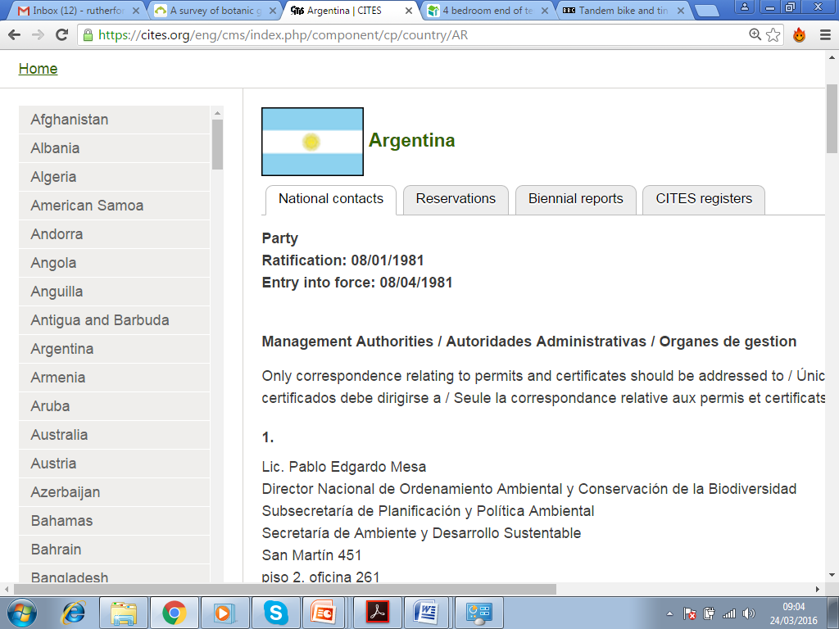
Who is my CITES MA?
Identify your CITES MA by checking the CITES list of national contacts and information and clicking on your country.

Slide 16
Are there any Registered Scientific Institutions in the region?
Before sending material to another institution, check whether there are any registered scientific institutions in the region.
Make sure that the part of the institution to which you are sending material is registered -the botanic garden may be registered but not the herbarium or vice versa.

Slide 17
Summary
You can move CITES material between CITES Registered Scientific Institutions without the need for costly permits by using your label attached to the outside of the package.
To become a CITES Registered Scientific Institution you must be a bona fide scientific institution, according to the criteria set out in Resolution Conf. 11.15 (Rev. CoP12)
In order to register contact your CITES national Authorities with the relevant information.
They confirm that you are authentic and contact the CITES Secretariat who include you in the CITES Register.

Slide 18
Summary
Nominate a lead person to operate this scheme within your institution. Provide their email on the registration form, on reports and on the labels. This will ensure that if there are queries or material is held up at Customs there is one central point of contact.
Do not forget to produce an annual report on your use of the label.
When sending material to another registered institution use your labels with your five-digit number. When the material is being returned to you the label should be from that institution with their five-digit number on it. Do not give your labels to others to use.

Slide 19
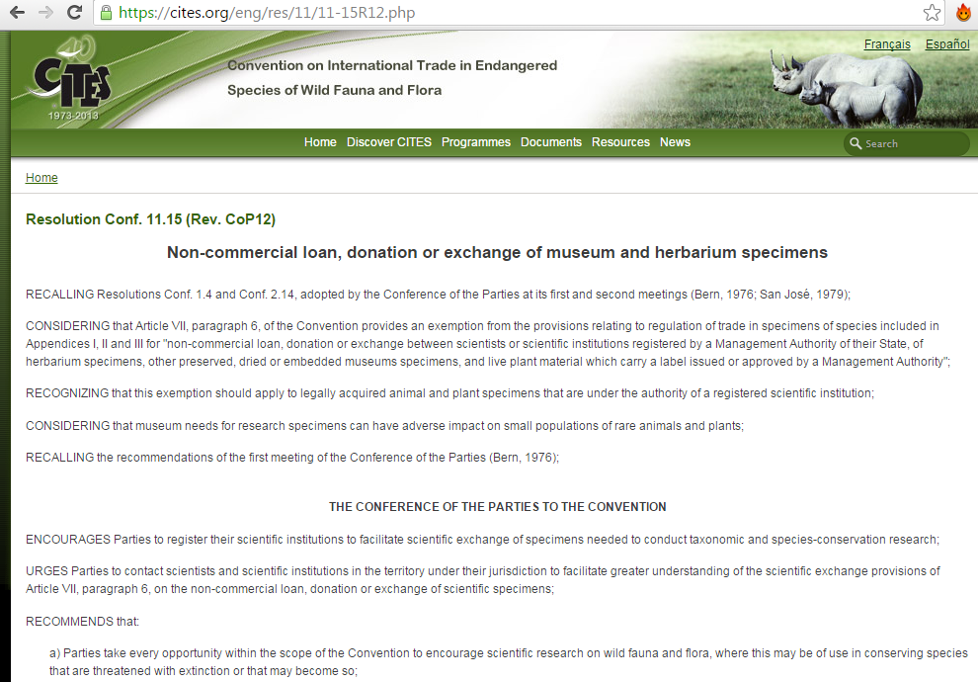
More information

Slide 20
End of Module 4: CITES and Scientific Institutions
Why not try the quick quiz?
Then, please go to Module 5

