Slide 1
Module 3: CITES and Stricter Measures The European Union
People
Plants
Places
Science

Slide 2
Stricter Measures
Under Article XIV of the Convention, Parties are allowed to take stricter measures than the provision of CITES, for instance more stringent import or export requirements.
There may be several reasons to take stricter measures; a Party may feel the provisions of CITES do not adequately conserve their native species, or they could be a regional economic integration organisation (REIO), allowing free movement between states without border controls.
For example, the European Union (EU), Japan and the US require import permits for some or all of Appendix II species, and Australia demands proof of management plans from exporting countries before allowing imports.
In addition, Australia, the EU and the US have all passed legislation in the last few years designed to exclude illegal timber from their supply chains.

Slide 3
The European Union
The Member States of the EU are one of the largest global markets for trade in wild animals and plants and their products and derivatives.
The EU applies CITES provisions through the EU Wildlife Trade Regulations that are directly applicable in all Member States.
This module will detail the stricter measures adopted by the EU.

Slide 4
The European Union
The first Regulation to implement CITES uniformly throughout the European Community (EC), as it was known at that time, came into force in 1984 (Council Regulation (EC) 3626/82).
A common regulation was necessary due to the lack of border controls and the free movement of trade. However, the ability of the EC to enforce CITES depends on the enforcement capabilities of its weakest Member States.
CITES implementation was patchy throughout the Member States and this regulation was criticised as unenforceable.

Slide 5
The European Union
In 1997 the European Union (EU), as it became known in 1993, replaced the 1982 Regulation with the EU Wildlife Trade Regulation (Council Regulation (EC) 338/97).
This Regulation was further strengthened in 2007, when the Commission adopted a series of recommendations for improving enforcement throughout Member States.
In response to the current high level of wildlife trafficking the European Commission has launched a stakeholder consultation on the future EU approach to wildlife trafficking. This has led to a roadmap relating to the development of an EU Action Plan against wildlife trafficking.

Slide 6
The EU and the Gabarone Amendment
The initial text of CITES foresaw that only States could be Parties to it and not REOIs. Subsequent multilateral environmental agreements (MEAs), such as the CBD, allowed such membership and the 4th Conference of the Parties held in 1983 adopted the Gabarone Amendment which would allow REOIs to accede to CITES.
This amendment was finally ratified in 2013 when two thirds of Parties accepted it. On 6 March 2015 the EU acceded to CITES.
The EU is now a Party to CITES in its own right and is able to vote at the CoP, as is each individual Member State.

Slide 7
The EU Wildlife Trade Regulations
The EU Wildlife Trade Regulations (EU WTR) consist of the following:
Council Regulation No 338/97 - the Basic Regulation
Commission Regulation (EC) No 865/2006 - the Implementing Regulation
An excellent reference guide to the EU WTR has been produced by the European Commission and TRAFFIC.

Slide 8
The EU WTR
The EU WTR goes beyond CITES in many circumstances. The main differences are:
Species are listed in Annexes (A,B,C and D) and not Appendices
Annexes contain non-CITES species
There are stricter import conditions for species in Annexes A & B
Import permits are also required for Annex B, import notifications for Annexes C & D
Restrictions on internal trade in Annex A species
Annex D contains non-CITES species which may be eligible for listing and for which import levels are monitored.
If operating in or out of the EU the Annexes should be consulted.
An explanation of the differences between CITES and the EU WTR can be found here.

Slide 9
Annex A, B, C
The Annexes are available at the European Commission webpage and on Species +. Like the Appendices, the Annexes list fauna first followed by flora, and species are listed alphabetically by family. The annotations may be slightly different from the Appendices.

Slide 10
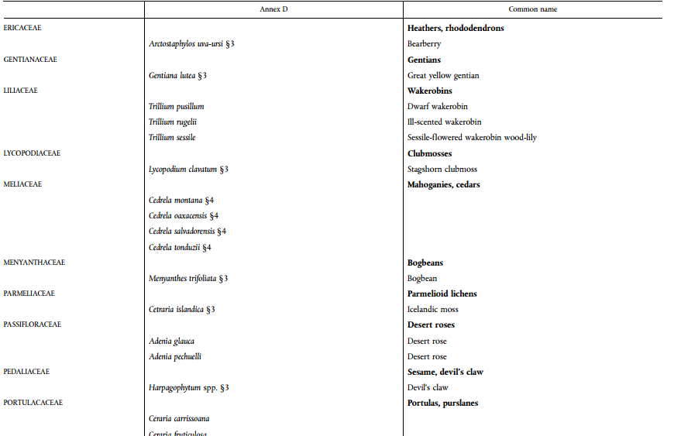
Annex D
Annex D species are listed separately at the at the bottom of European Commission webpage.

Slide 11
Annex A
Annex A is equivalent to Appendix I. It contains the following:
All CITES Appendix I species, except where EU Member States have entered a reservation;*
Some CITES Appendix II and III species, for which the EU has adopted stricter domestic measures;
Some non-CITES species.
*A reservation is a unilateral statement by a
Party not to be bound by the CITES provisions
or a species listing, for instance if a species is not
yet covered by a Party’s national legislation.
©CONAP
Fitzroya cupressoides

Slide 12
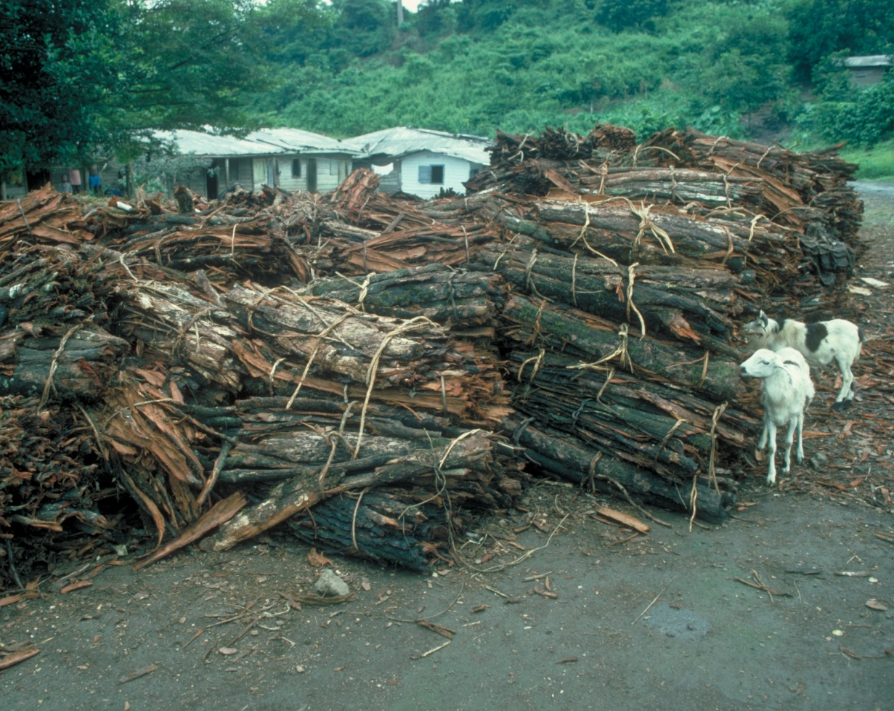
Annex B
Annex B is equivalent to
Appendix II. It contains the
following:
All other CITES Appendix II species, except where EU Member States have entered a reservation;
Some CITES Appendix III species;
Some non-CITES species.
©RBGKew
Bark of Prunus africana

Slide 13
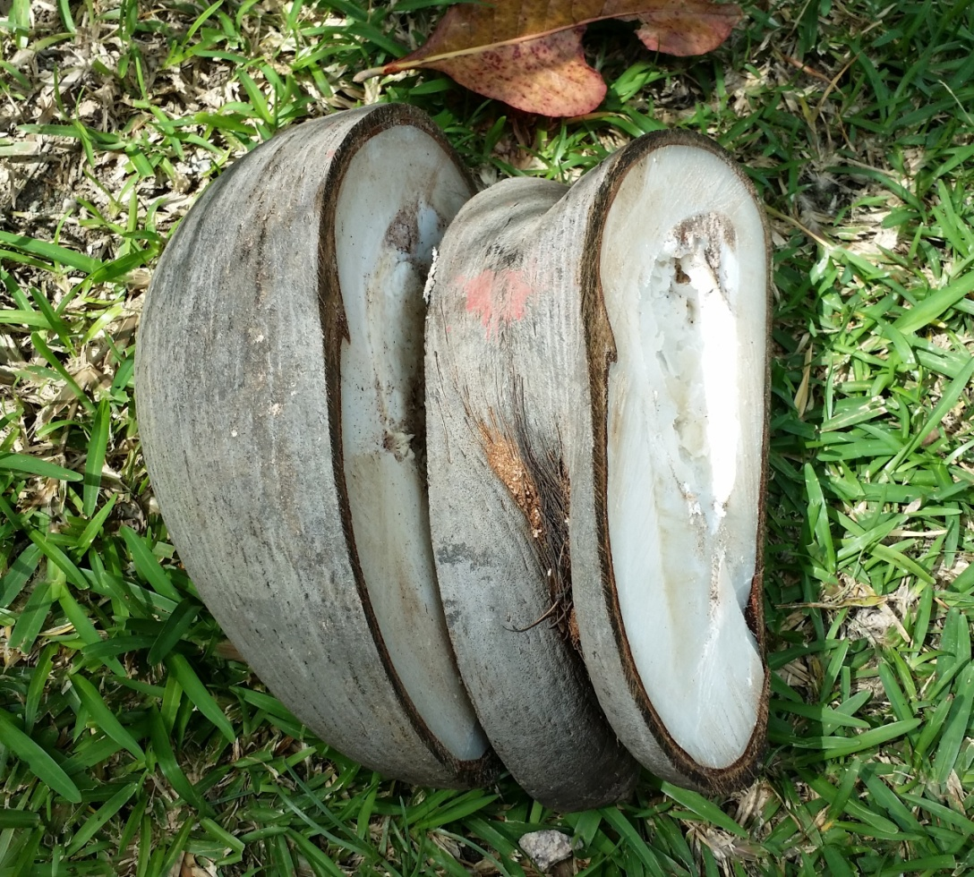
Annex C
Annex C is equivalent to
Appendix III. It contains the
following:
All other CITES Appendix III species, except where EU Member States have entered a reservation.
©Mario Gisiger
Kernel of Lodoicea maldivica

Slide 14
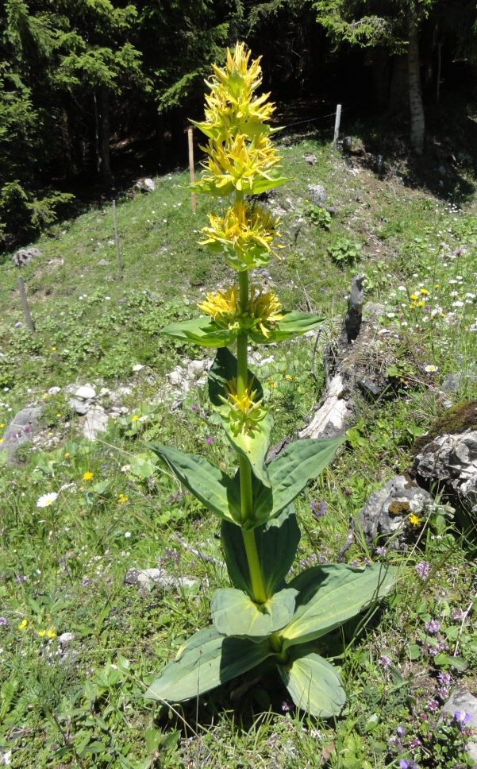
Annex D
Annex D has no CITES equivalent. It
contains the following:
Some CITES Appendix III species for which the EU holds a reservation;
Some non-CITES species in order to be consistent with other EU regulations on the protection of native species, such as the Habitats Directive and the Birds Directive.
©Wikipedia Creative Commons
Gentiana lutea

Slide 15
Permit Requirements
Annex A: Country of origin Export Permit and EU Import Permit
Annex B: Country of origin Export Permit and EU Import Permit
Annex C: Country of origin Export Permit or Certificate of Origin and EU Import Notification
Annex D: EU Import Notification
There is free movement of CITES material within all Member States once the
material has entered the EU. For example an orchid shipped from Bolivia to
France with the correct permits can then move without permits to the UK
Some overseas territories are treated as the EU (e.g. Canary Islands) while
others (e.g. UK Overseas Territories) are not and full CITES permits are required.

Slide 16
Internal Trade in Annex A Species
Internal commercial trade or display of wild Annex A material is generally prohibited but there are specific exemptions through the issuance of a certificate under the following conditions:
Material acquired before the species was listed (pre-Convention/ Regulation), or, for ornaments and musical instruments etc that were worked and acquired before 3rd March 1947;
Material that is artificially propagated;
Material that has been introduced into the EU for research, conservation, breeding or educational purposes or taken legally from another Member State.

Slide 17
Internal Trade in Annex A Species
Certificates, known as Article 10s, can be for a specific transaction (“transaction specific”) or remain with the specimen (“specimen specific”).
Instead of issuing Article 10 certificates on a case-by case basis, zoos, botanical gardens or similar establishments can be issued a single certificate, known as an Article 60, as an exemption. The institution, approved by the MA in consultation with the SA, must be involved in artificial propagation/ research/ education programmes to conserve species.
A certificate is not needed to possess an Annex A specimen.

Slide 18
The EU Process
The stricter measures outlined in the EU WTR allow the European Commission to establish import restrictions with regard to certain species/ countries.
Once a CITES specimen has entered a Member State it can move freely within the 28 countries. If one Member State has inadequate border controls or partial enforcement this can undermine implementation within the whole EU.
When a Member State’s SA has doubts about the sustainability of an import and advises its MA to refuse a permit on conservation grounds it will inform the Commission and the other States’ Authorities and imports of this species/ country combination will be suspended.
The application will then be discussed at the Scientific Review Group (SRG).

Slide 19
The Scientific Review Group
The Scientific Review Group (SRG) consists of Member States’ Scientific Authorities, who meet four times a year in Brussels to discuss scientific and trade issues and permit applications.
After looking at the scientific aspect of the case the SRG may form one of three opinions:
Positive - trade allowed
Negative - Commission contacts exporting country asking for more information, on the basis of which opinion may be changed to positive or an import suspension established, adopted by all Member States
No opinion - three possible options, the most restrictive refers every application of this country/ species combination to the SRG.
Where there is no SRG opinion the decision is taken by the SA of the importing Member State.

Slide 20
SRG Process
The process creates a dialogue between the EU and range States.
EU is able to target aid to support sustainable trade. For example, the EU is one of the largest funders of the ITTO-CITES programme on tree species.
Long-term trade suspensions are a last resort.

Slide 21
SRG Process
All SRG opinions arising from a meeting are posted online within five days on Species +. This image shows some of the numerous decisions the SRG has made on Prunus africana.

Slide 22
End of Module 3: CITES and Stricter Measures
The European Union
Why not try the quick quizzes for
Module 2 and Module 3
Then, please go to Module 4

