Slide 1
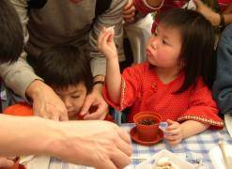
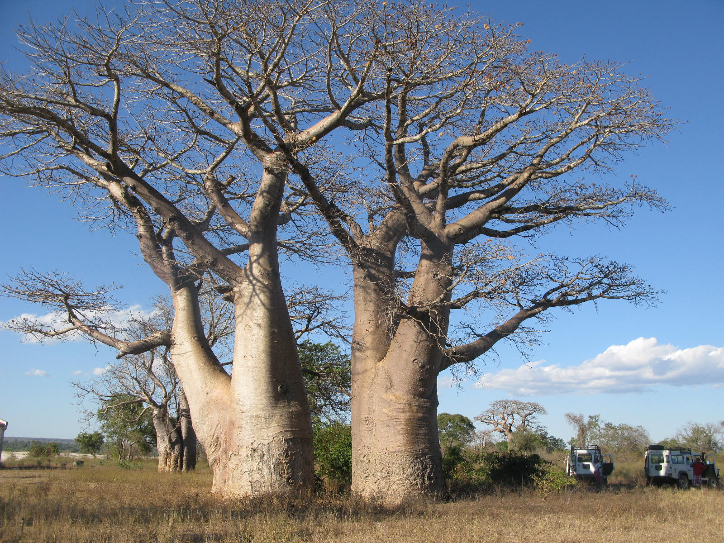
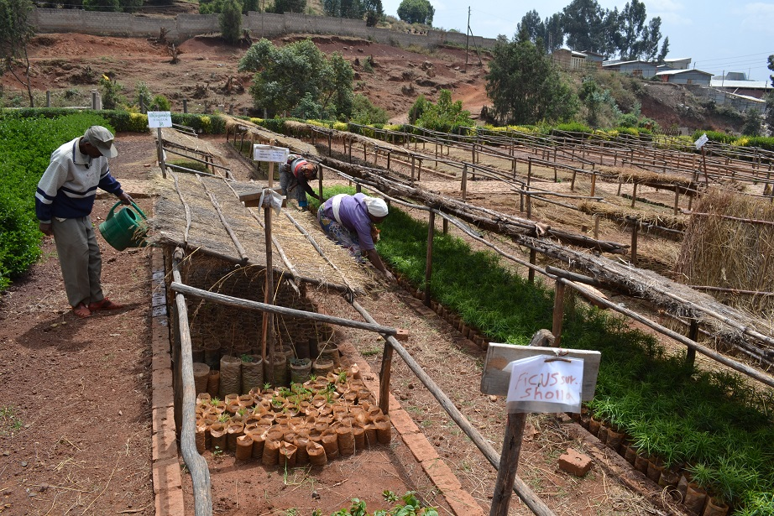

Module 6: Developing Contracts and Agreements
People
Plants
Places
Science
Notes:
To change the images at the bottom of the slide:
Select the individual image box (e.g. either people, plants, places or science), the easiest way do this by clicking on the very edge of the box
Right click and go to ‘Format picture’ (bottom option)
Go to ‘Fill’ (top option)
Select ‘Picture of texture fill’
Click ‘File…’ under ‘Insert from:’
This will take you to browse, find you image and insert
You will need to choose images that are roughly the right shape for the box, if needs be you can crop your desired image to that shape before hand and resave it. If you don’t do this it will stretch or squeeze your image and it’ll look strange.
If you’re image stretches out over all 4 boxes, it’s because you haven’t selected the right box. Press undo, and go back and select the one box you wish to insert the image into.

Slide 2
Introduction to Module 6
Model agreements and clauses are standard, off-the-shelf contracts and contractual terms that a garden may develop in order to comply with the Nagoya Protocol and national ABS legislation. In this module, we will outline some examples to consider.
This module will specifically cover:
  advantages and disadvantages to using model contracts
  example model agreements
  model clauses in non-commercial research access agreements
  useful sources of model agreements
There are advantages and disadvantages to using model agreements and clauses.

Slide 3
Advantages of using model contracts
The advantages of using model agreements and clauses include that:
they help to plan work – to focus and realise expectations
they are transparent and legally secure
model terms = predictability and standard practice – this helps with curation and implementation
they speed up the process – saving time and money
they clarify best practice where national legislation is not clear

Slide 4
Disadvantages of using model contracts
Disadvantages include that:
they can take time to set up
a model is only a model - terms need to be mutually agreed
when both parties have a model, there can be problems
sometimes models lead to complacency and failure to check/record terms
models need to be flexible to be used with other sectors and governments, who may have own models – capacity-building may be required to ensure that everyone understands the process and the final agreed terms

Slide 5
Examples of model agreements
It is useful to have a range of model agreements suitable for your garden’s circumstances and uses of material:
Use of material letter, setting out how material will be used by your garden
Donation letter, for potential donors (if no Material Transfer Agreement)
Material Transfer Agreements (MTAs) including terms of transfer to third parties (if allowed); different models for different departments if necessary
Memoranda of Collaboration (MoC) including terms of transfer to third parties (if allowed) – for simpler partnerships (e.g. for herbarium exchanges)
Access and Benefit-Sharing Agreement (ABSA) – for more complex partnerships/more sensitive material (e.g. for live germplasm)
MoC and ABSA renewal letters – simpler documents to continue a partnership
Approved translations

Slide 6
Model clauses in non-commercial research access agreements
Key terms to include in non-commercial research access agreements include:
Parties to the agreement
Nature of relationship/purpose of contract
Definition of genetic material being accessed – seeds, herbarium specimens, DNA, data/TK/information
PIC/legal access from provider
Definitions
Use of material (non-commercial/commercial)
Steps to take if change of use required
Terms of transfer and supply to third parties
Storage/disposal of the material

Slide 7
Model clauses in non-commercial research access agreements (2)
Benefit-sharing (monetary/non-monetary; short term/long term)
Intellectual property
Conservation/Sustainable Use
Reporting requirements and/or other means of sharing information on the implementation of the terms
Dispute settlement, including possible options for alternative dispute resolution (mediation or arbitration)
Choice of applicable law
Signatures

Slide 8
Useful sources for model agreements
The ABS Clearing House has links to these and other model agreements:
Bonn Guidelines
Swiss Academy of Sciences sample agreement and model clauses on ABS for non commercial research
Common Policy Guidelines for botanical institutes
MOSAICC project for transfer of microbial resources
ITPGRFA Standard Material Transfer Agreement
Case studies on BGCI ABS web pages

Slide 9
End of Module Six
(Model Contracts and Agreements)
Congratulations, you have finished the Learning Tool
Are you ready to give us some feedback?

